Slide 1
Italy Study Abroad 2023
AR260: Intro to Italian Art and Culture

Slide 2
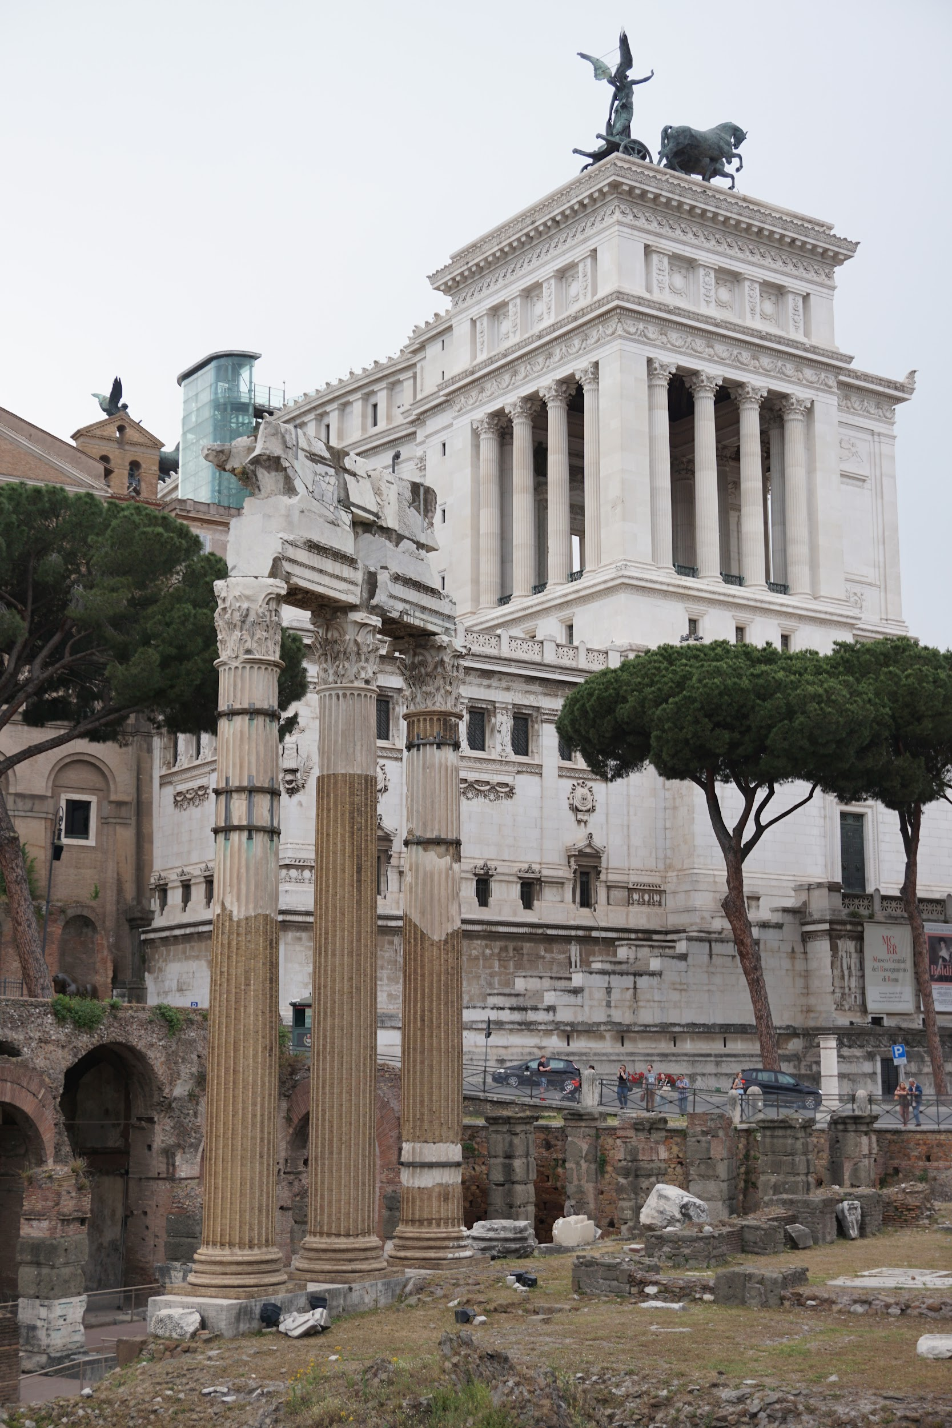
Key Information
April 30 - May 17
Fly into Rome, and return out of Venice, or continue on to other places in Europe or Italy!
A group will fly together from Minneapolis, but you can also meet at the airport in Rome.
Leaves the day after graduation, seniors can go too!
Will not delay graduation, and counts towards your degree.
Counts for 2 CEs (must register).
Application deadline December 1.
Estimated cost $3600-$4100
Includes housing, in-country transportation, entrance fees, and some meals
Flight to/from Italy is separate
Students must have up to date passport

Slide 3
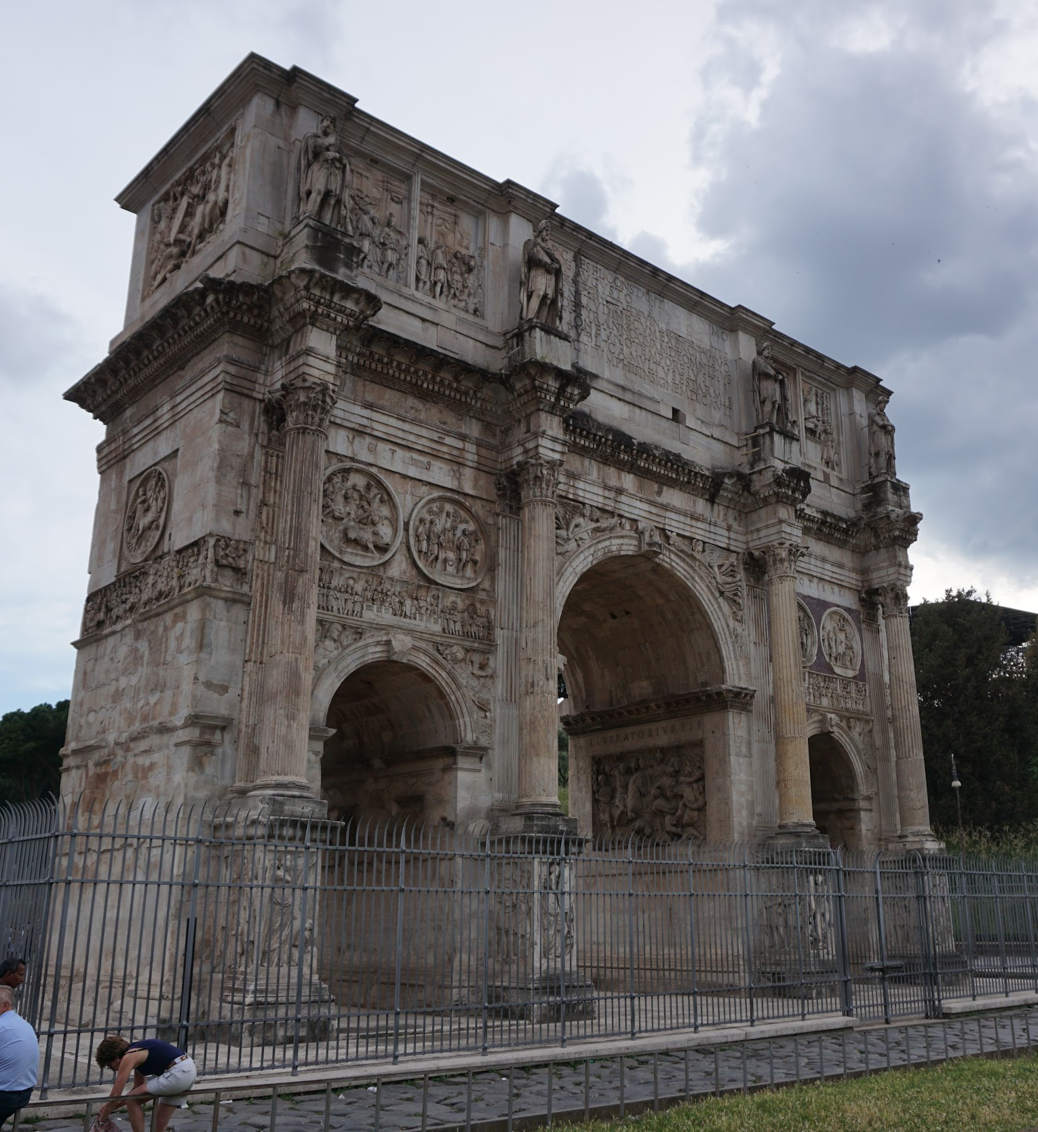
Key Information
Lead faculty Lisa Truax, assistant faculty Dean Beckman
Students cay fly out of different airport if it is closer to home (like Chicago) and meet in Rome with the group.
Class meets Tuesday evenings (7:00-8:30) the second half of the spring semester.
See and do the ‘big things’, but also balanced with free time to explore the cities with other students on the trip.

Slide 4
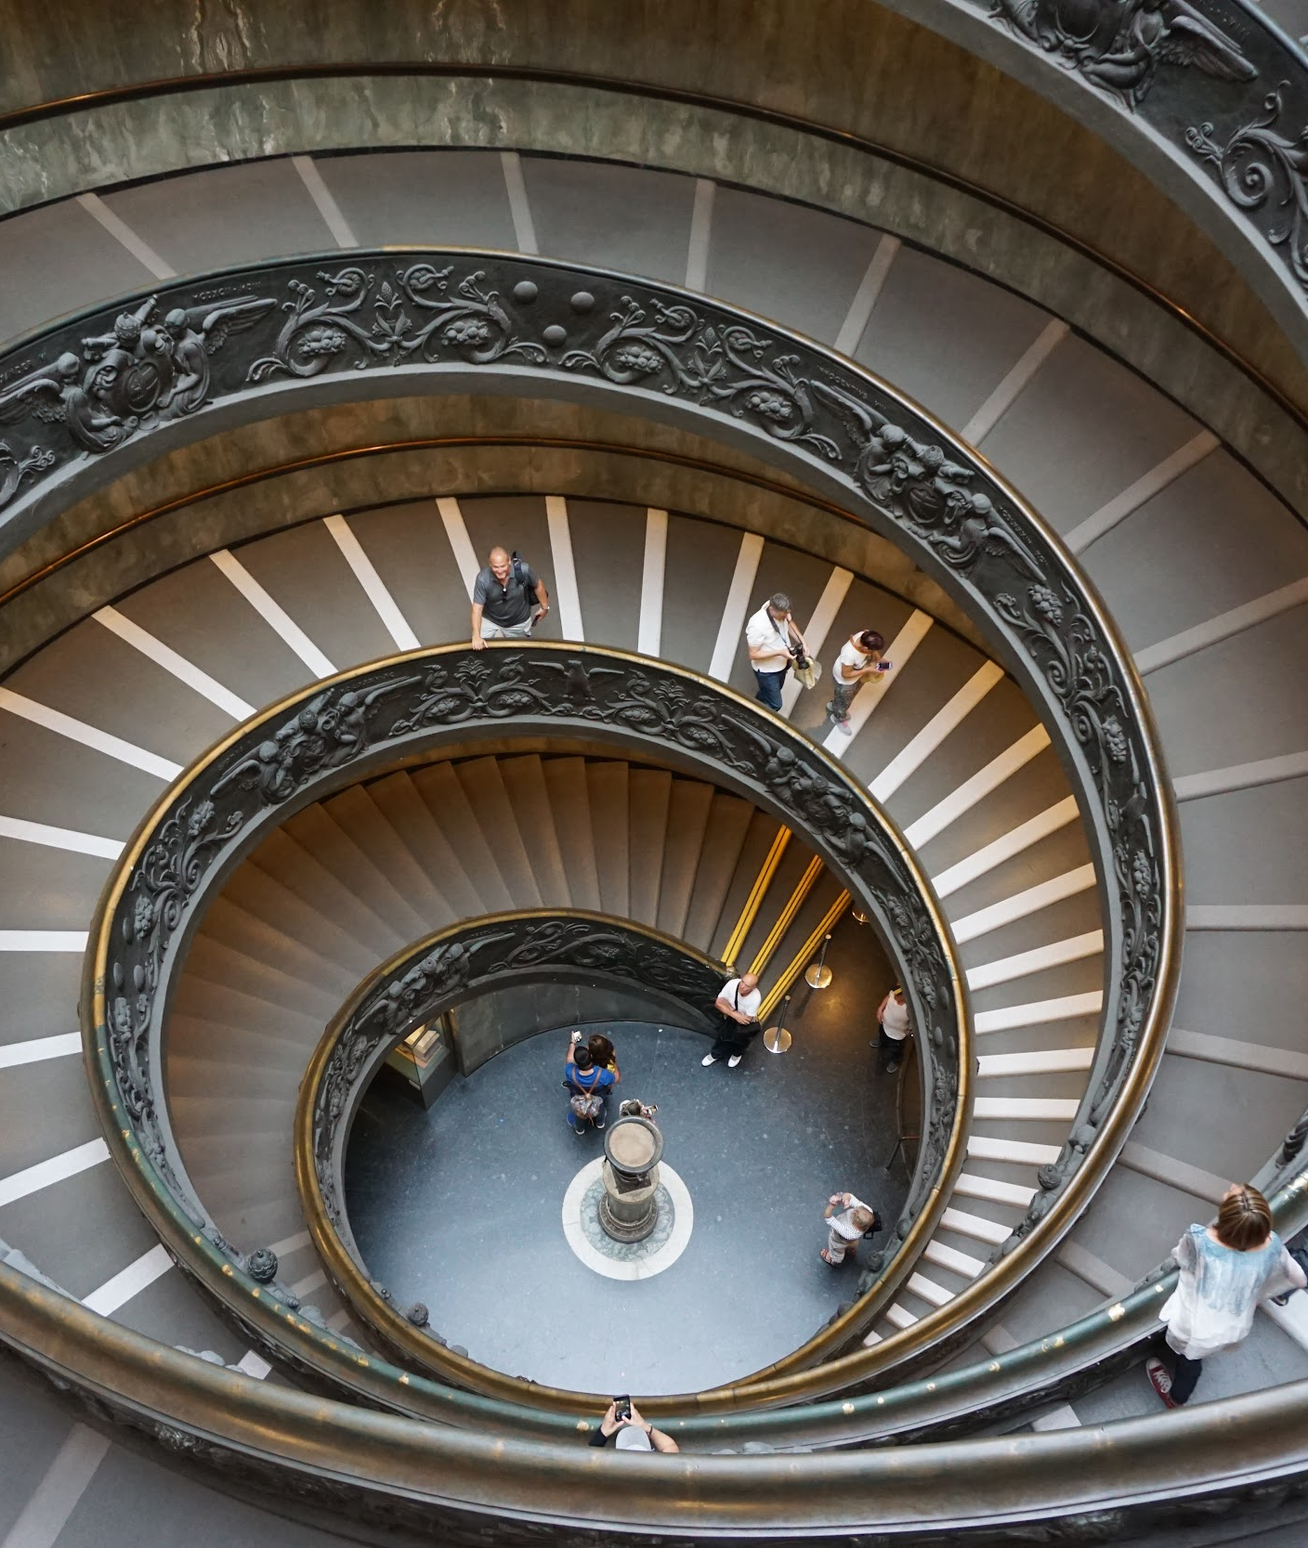
Rome / Vatican
Hotel Stay in central location
In-city travel via metro and walking
Highlights in Rome
Colosseum, Forum, Pantheon, Trevi Fountain, Vatican museum / Sistine chapel, St. Peter’s Basilica, Borghese museum, Spanish steps.
Pizza at Pasquale’s

Slide 5
Colosseum

Slide 6
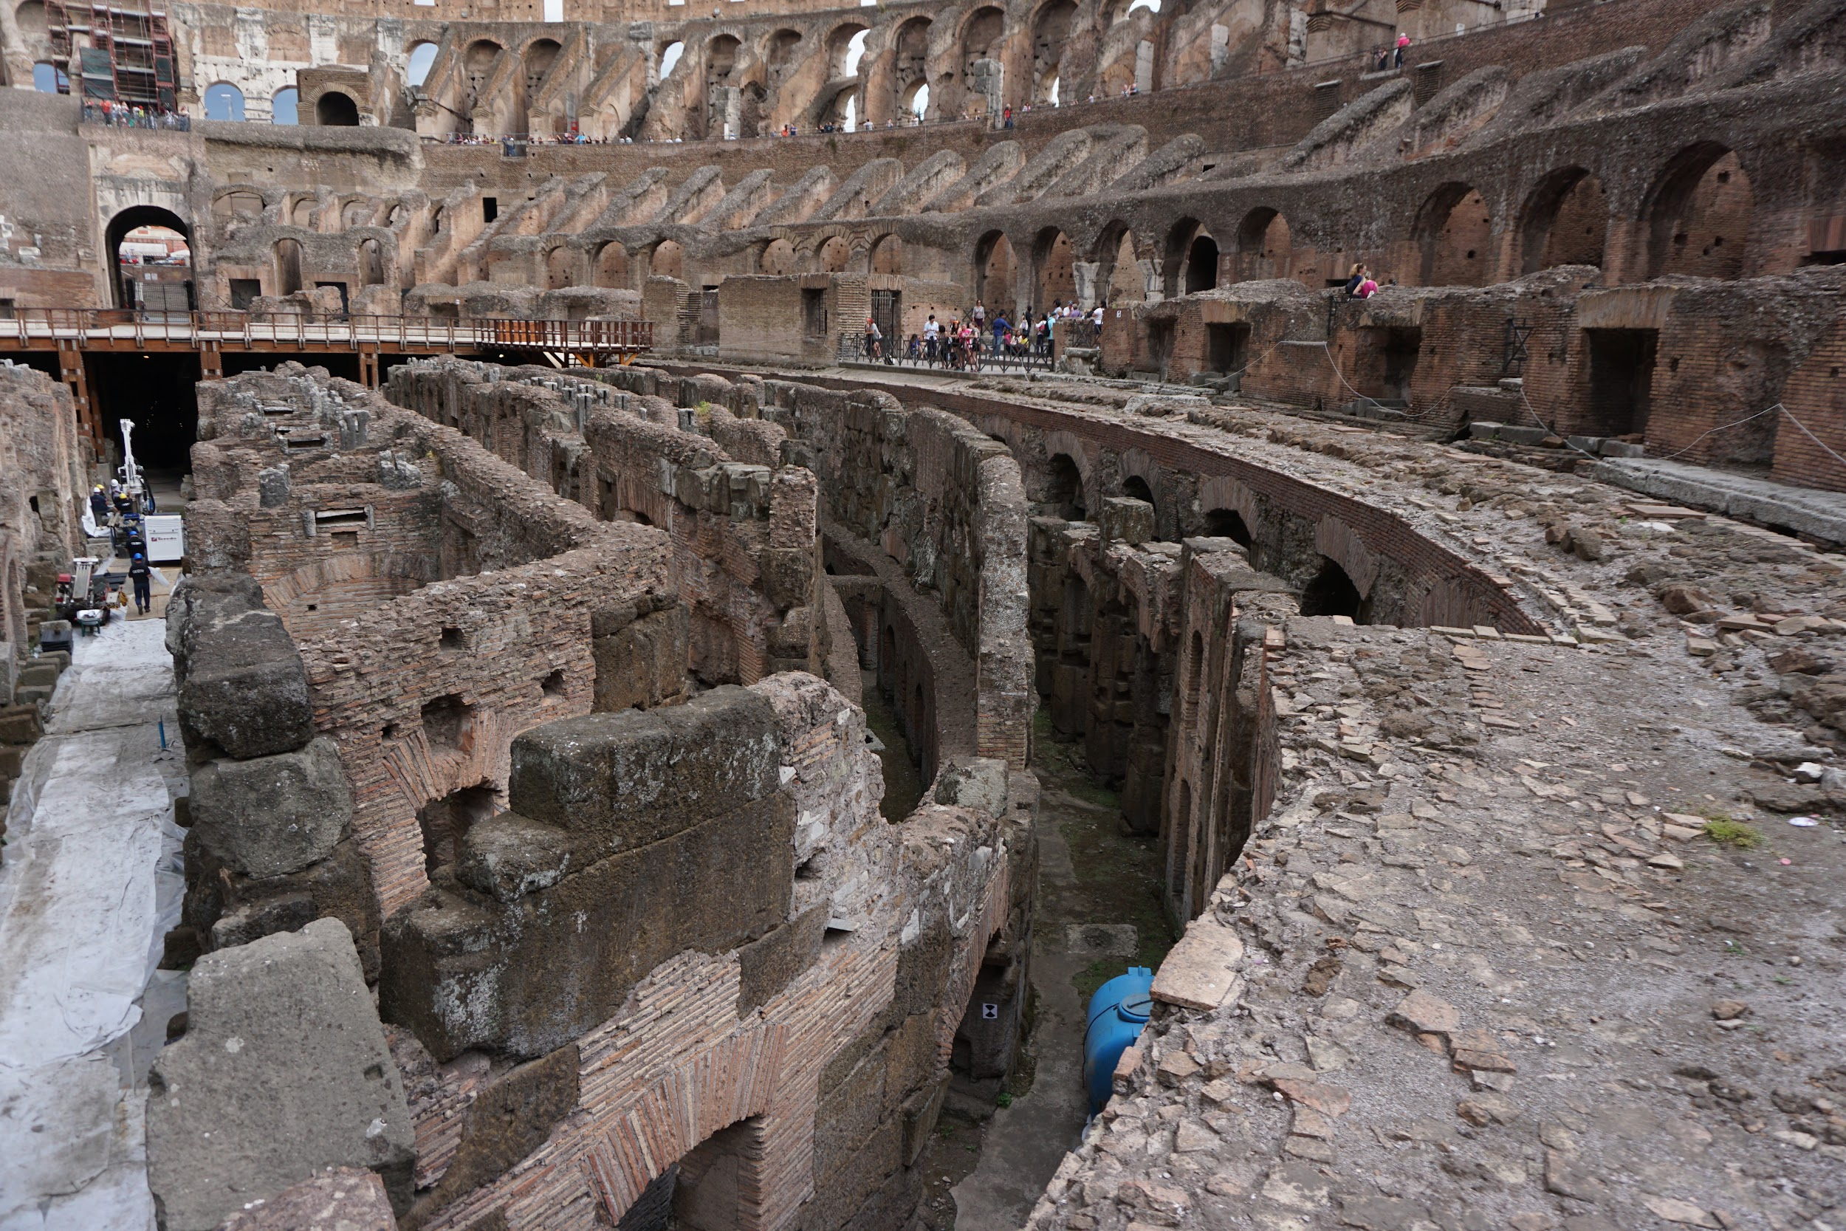

Slide 7
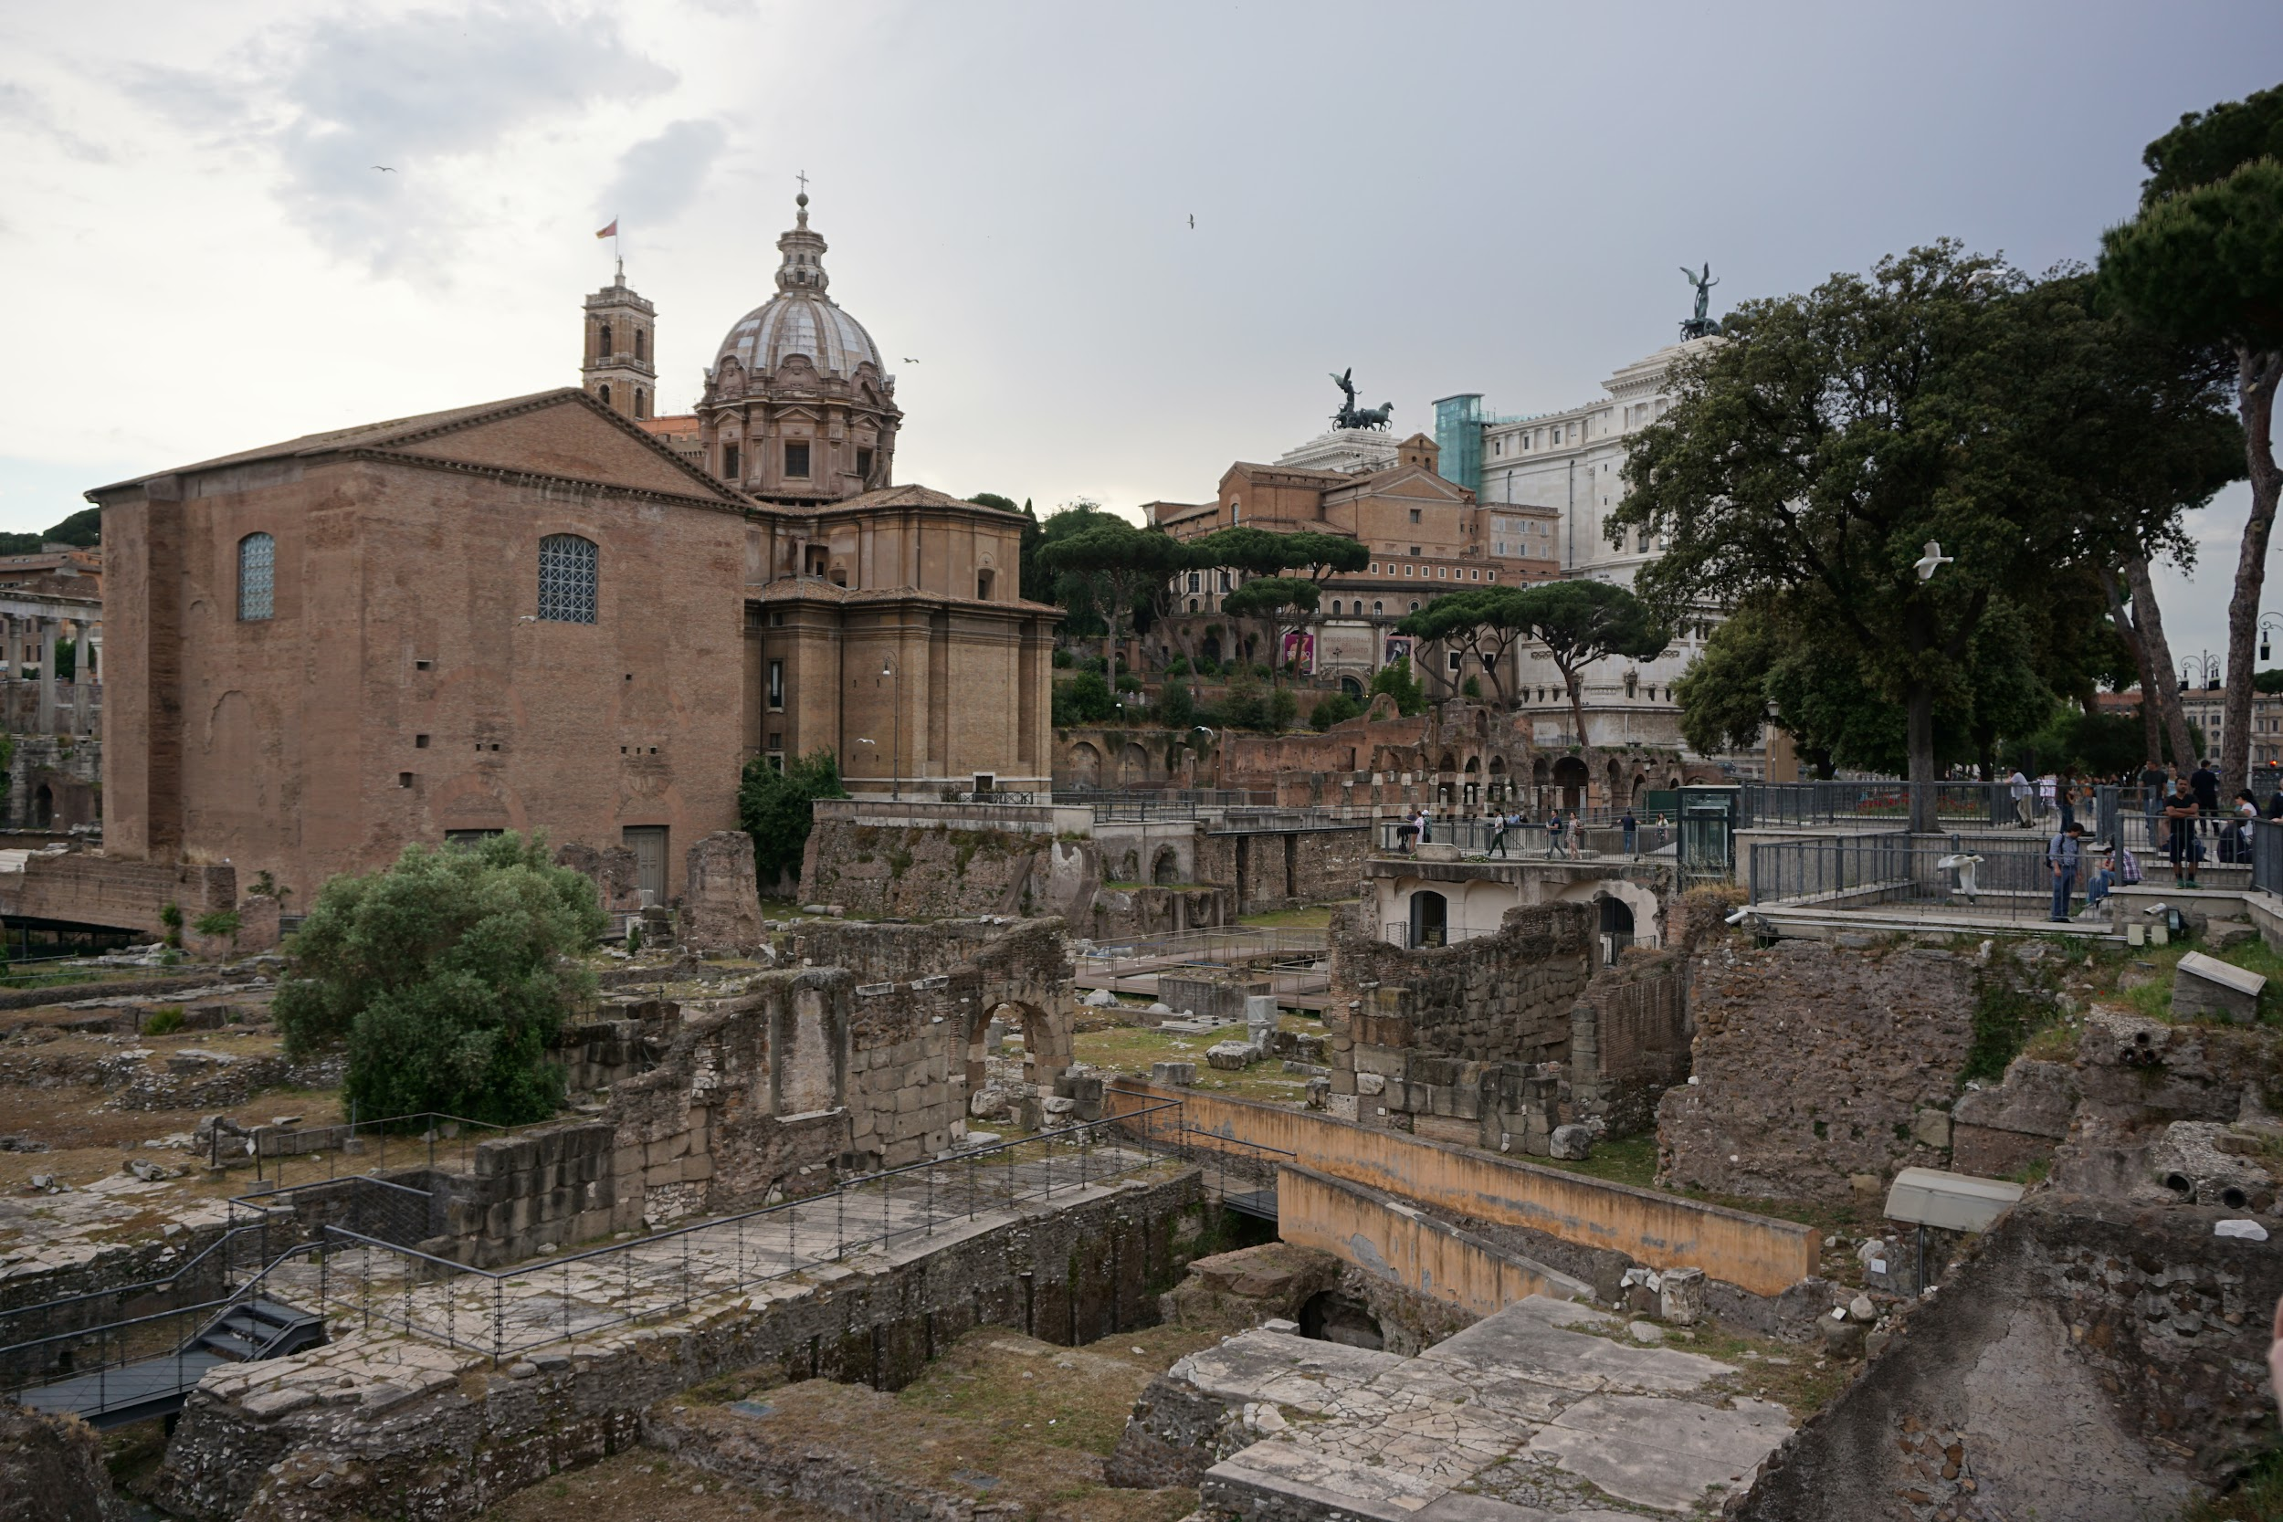
Roman Forum

Slide 8
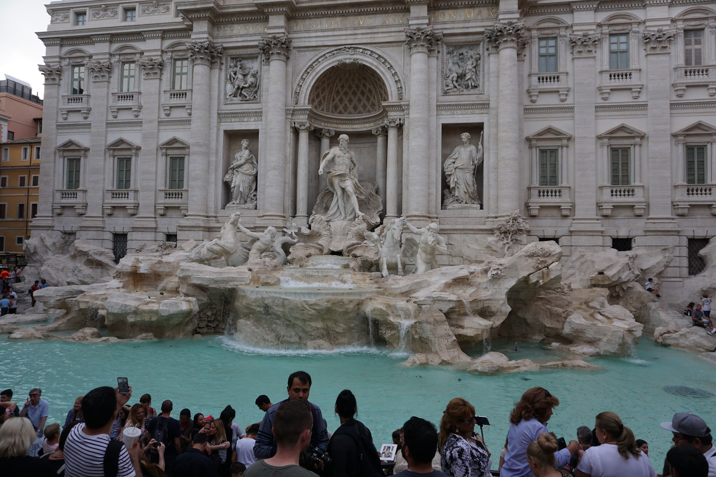
Trevi Fountain
“If you throw one coin: you will return to Rome. If you throw two coins: you will fall in love with an attractive Italian. If you throw three coins: you will marry the person that you met.”

Slide 9
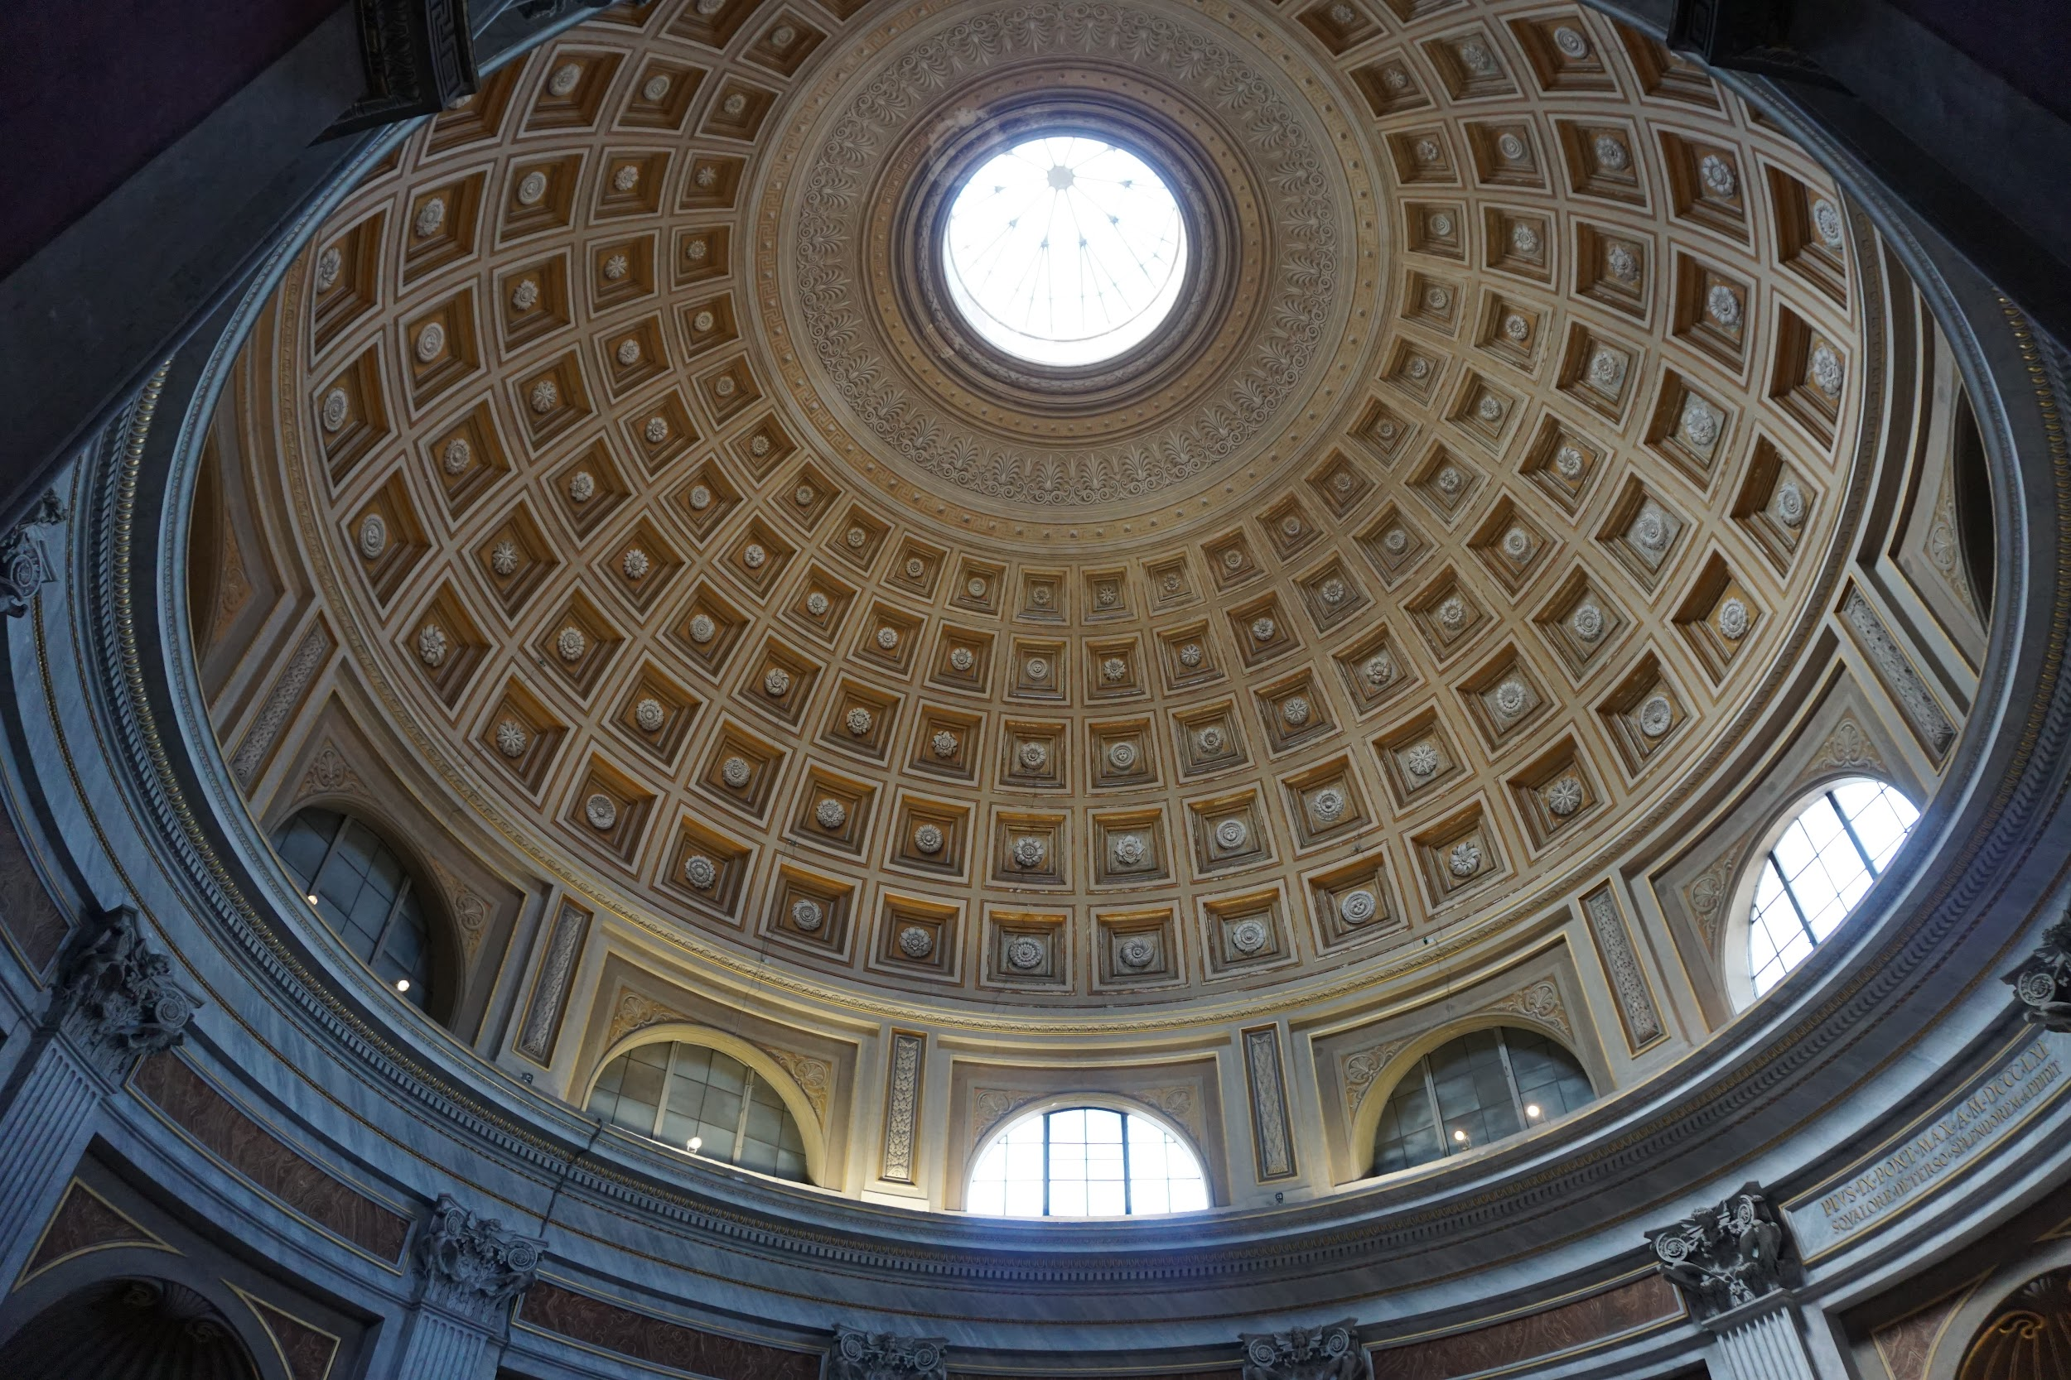
The Pantheon: former Roman temple and, since 609 AD, a Catholic church in Rome

Slide 10
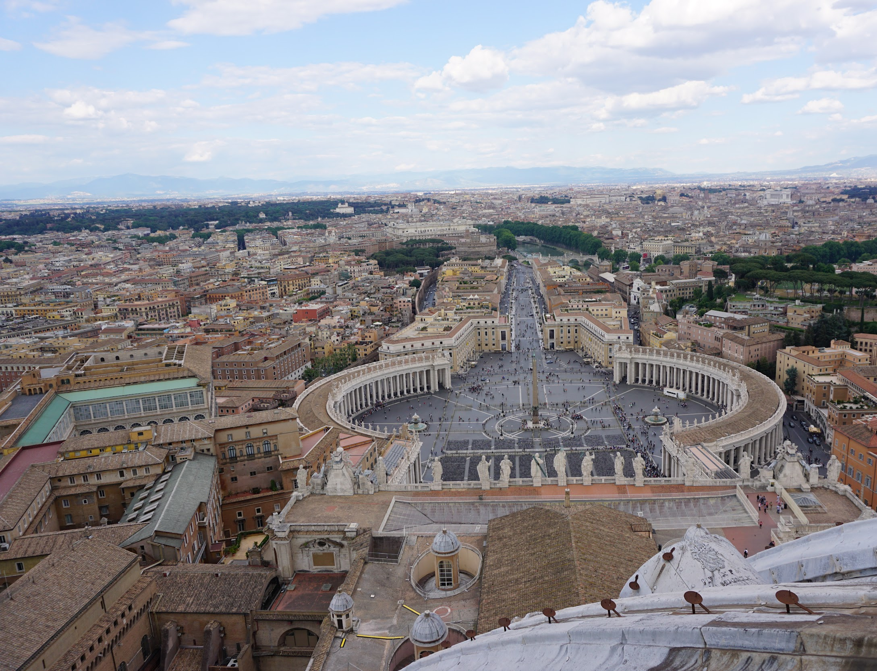
View from St. Peter’s Dome

Slide 11
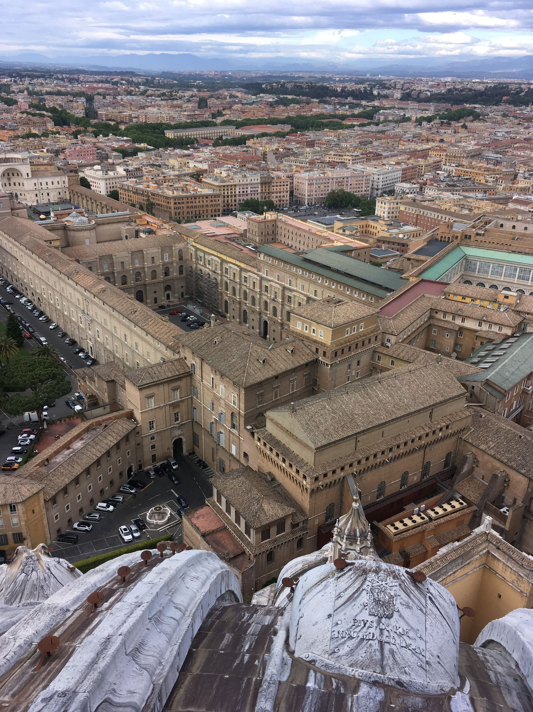

Slide 12
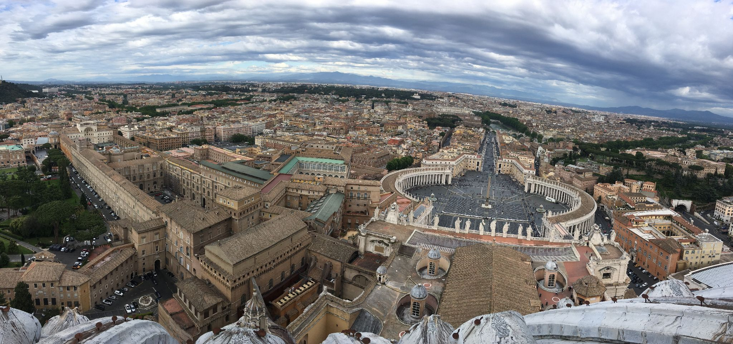

Slide 13
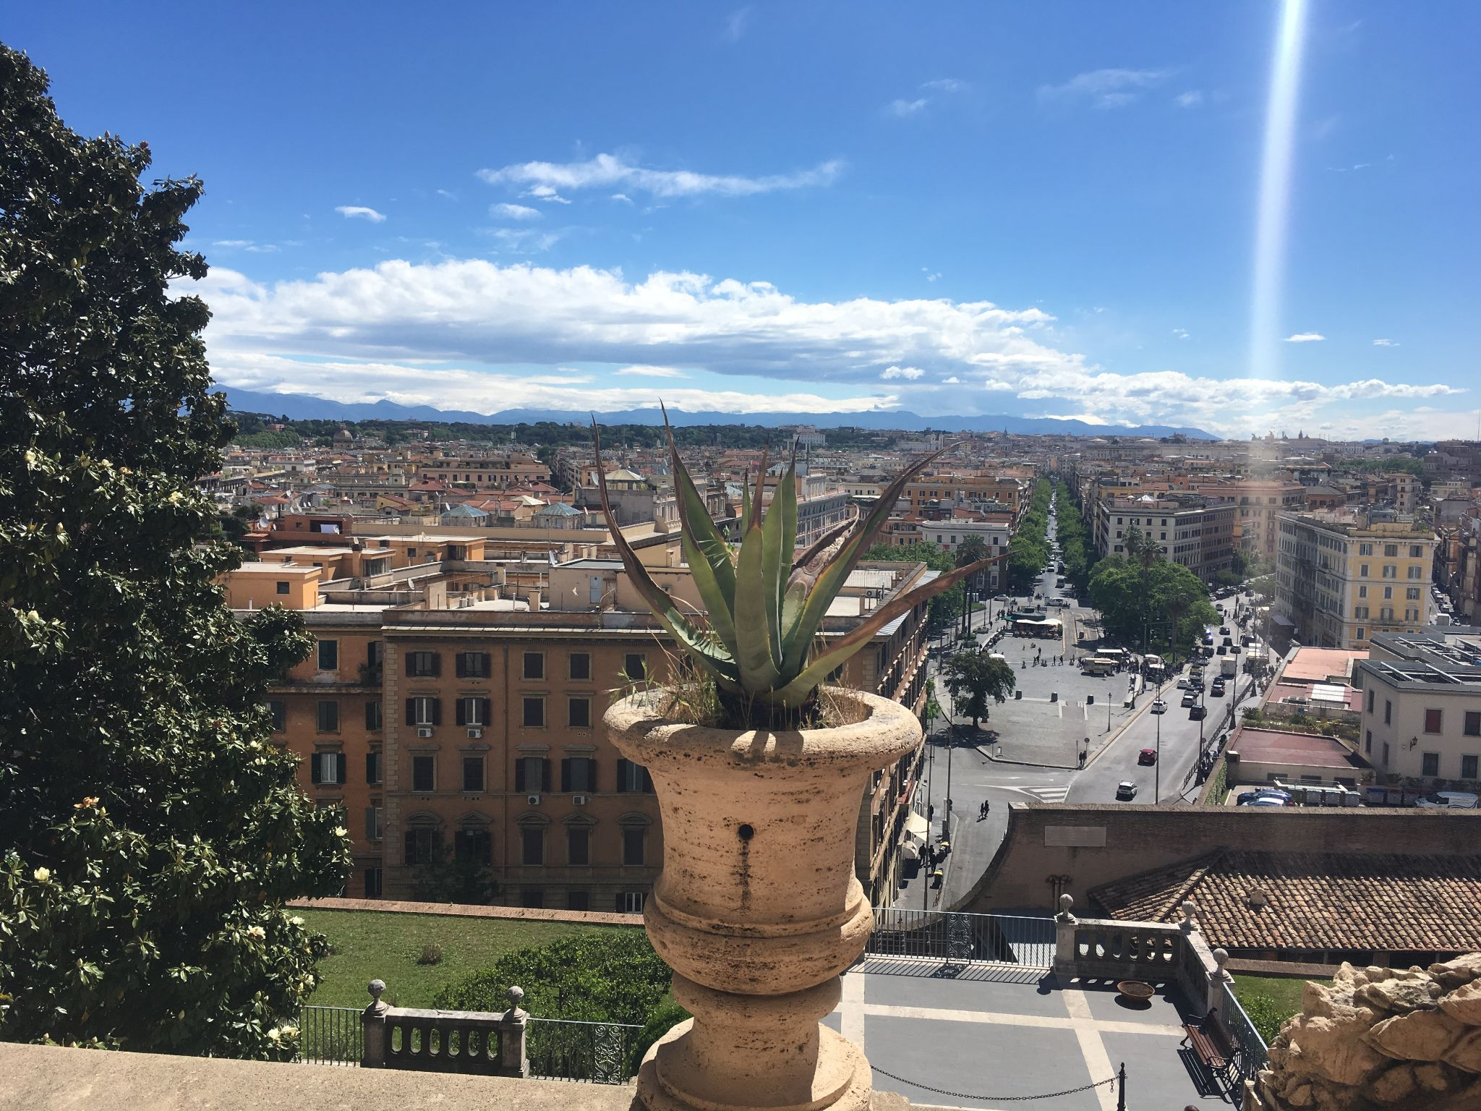

Slide 14
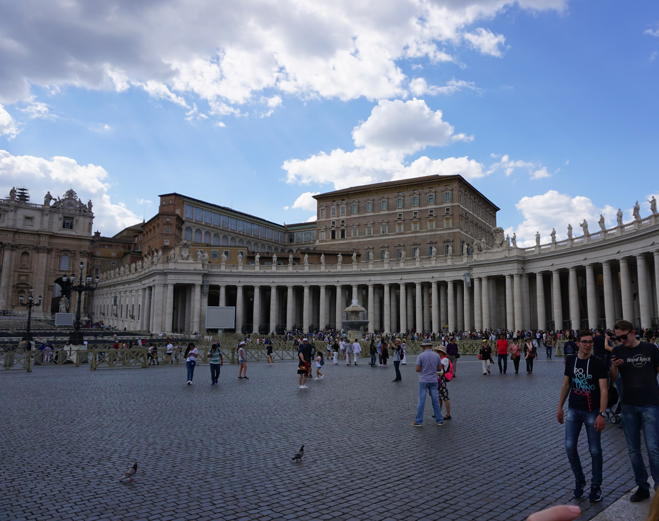
Piazza San Pietro (St. Peter’s Square)

Slide 15
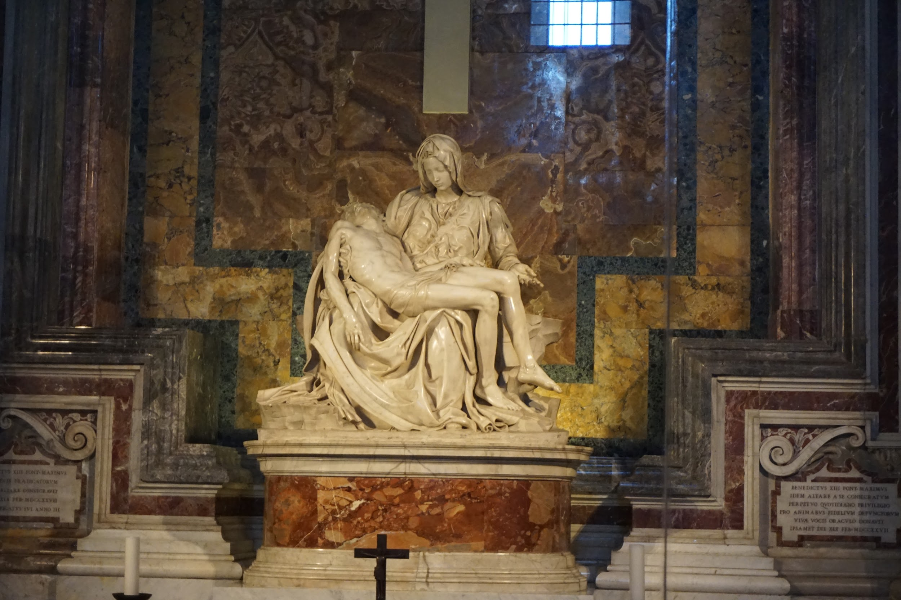
Pietà,Italian Renaissance, Michelangelo Buonarroti

Slide 16
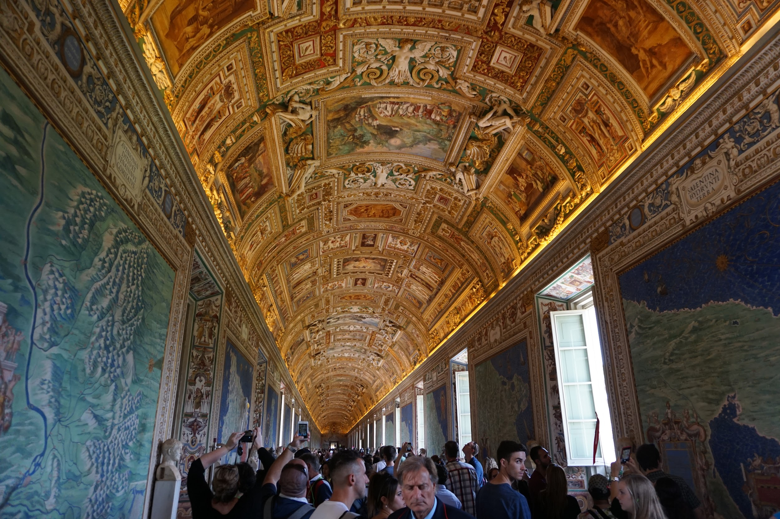
Vatican Museum: map room

Slide 17
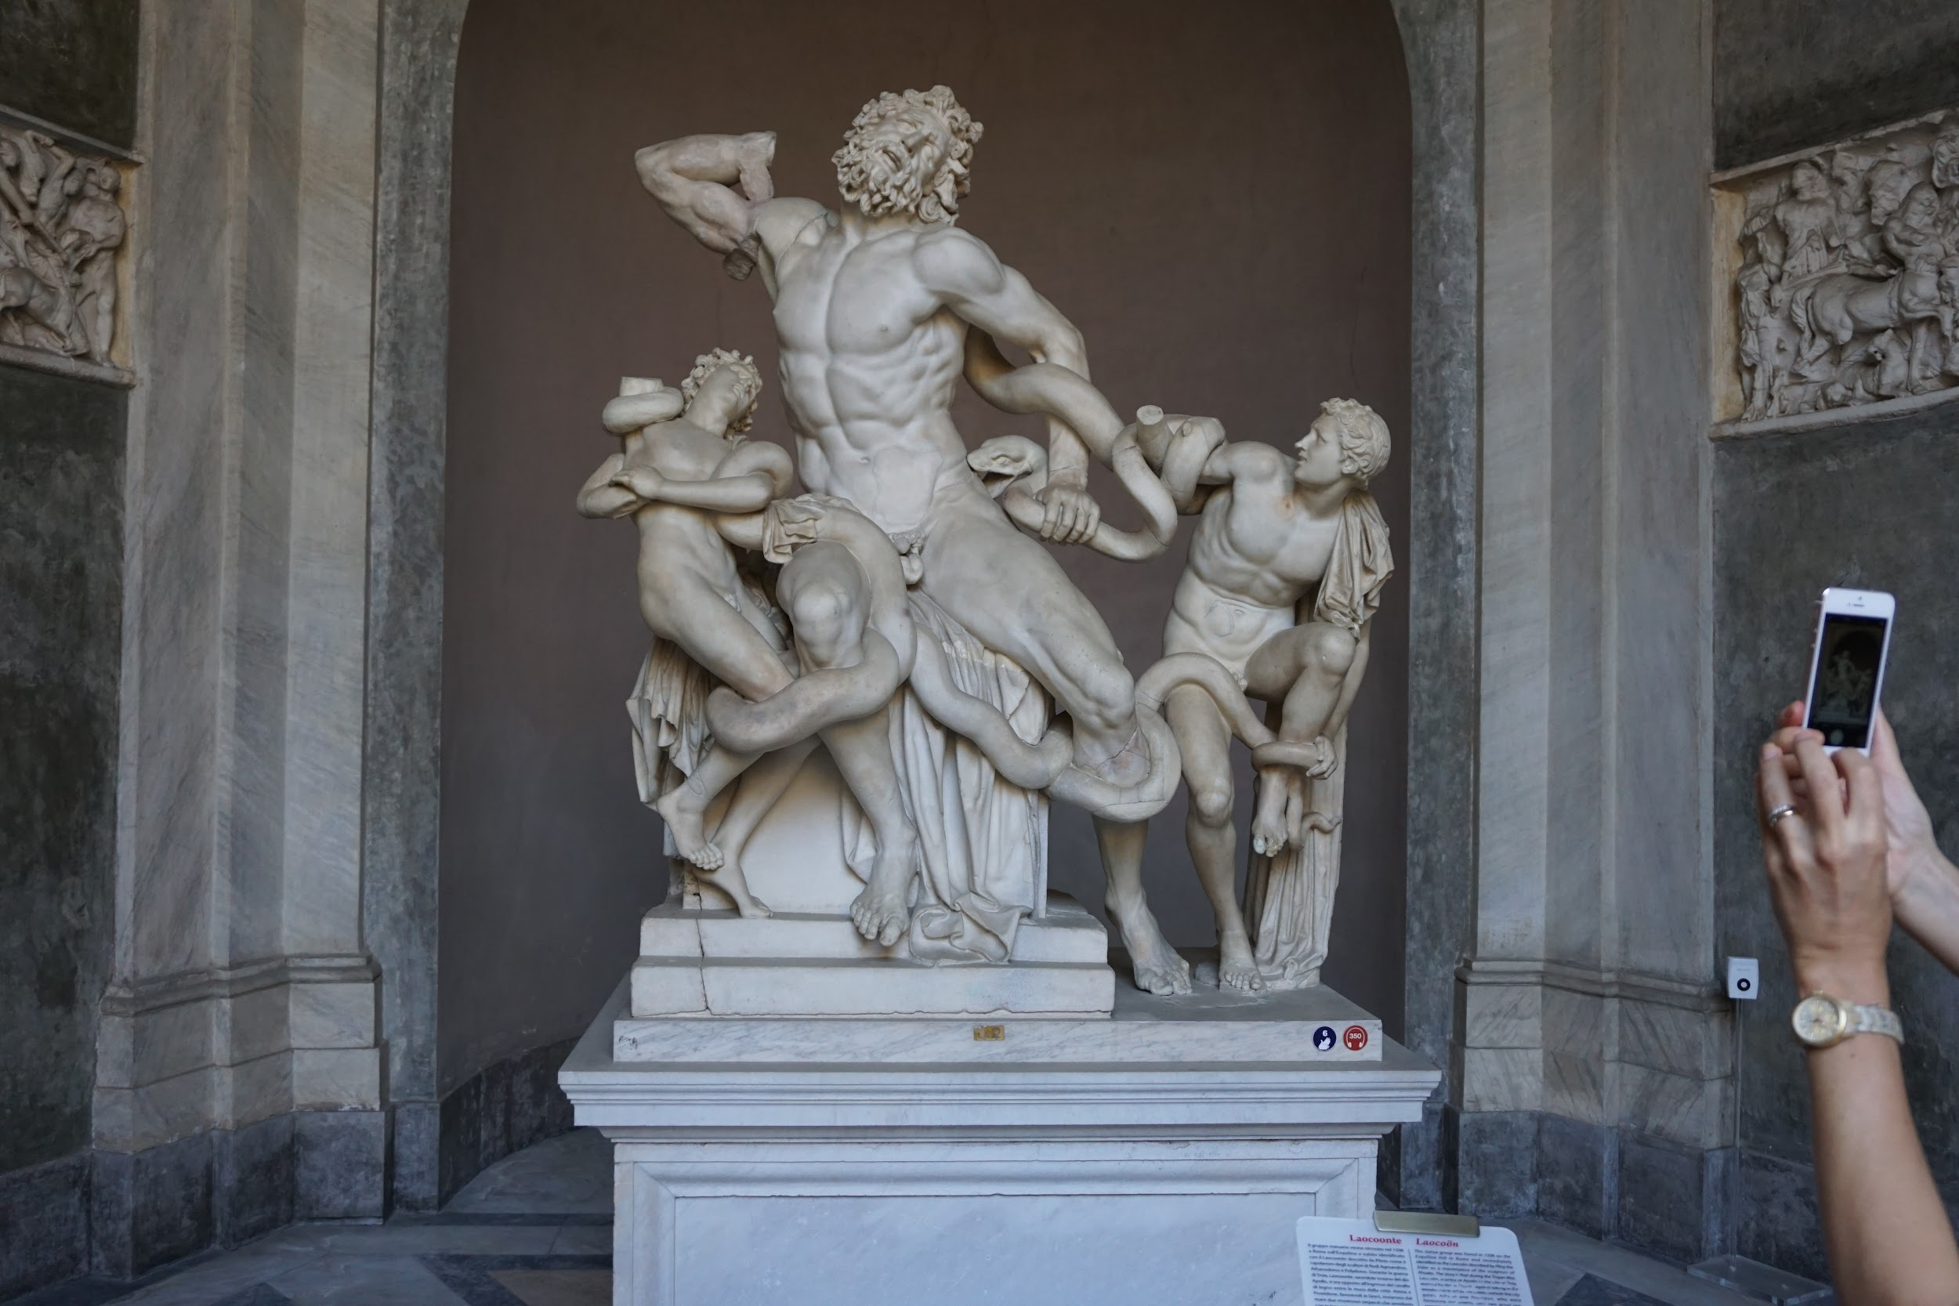
Vatican Museum: Laocoön & Antiphantes and Thymbraeus

Slide 18
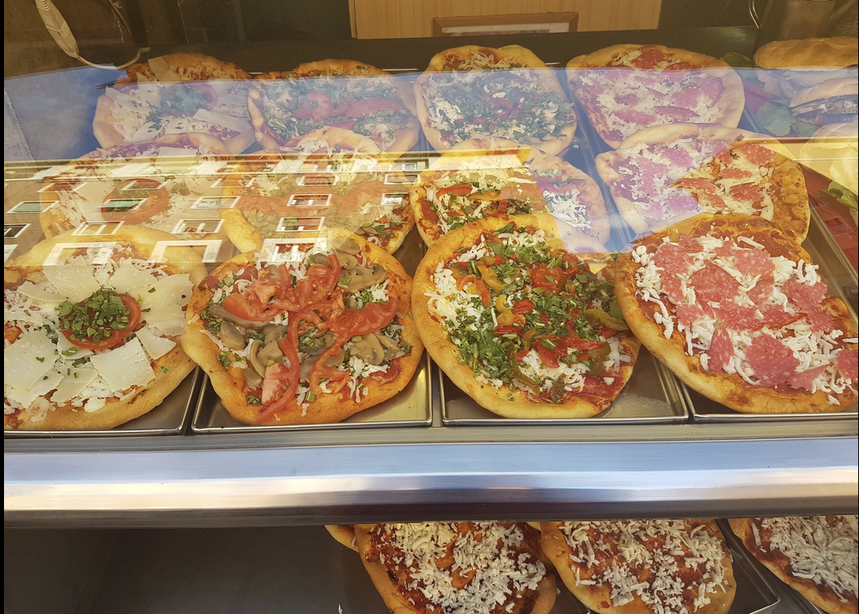
Pasquale’s Pizza

Slide 19
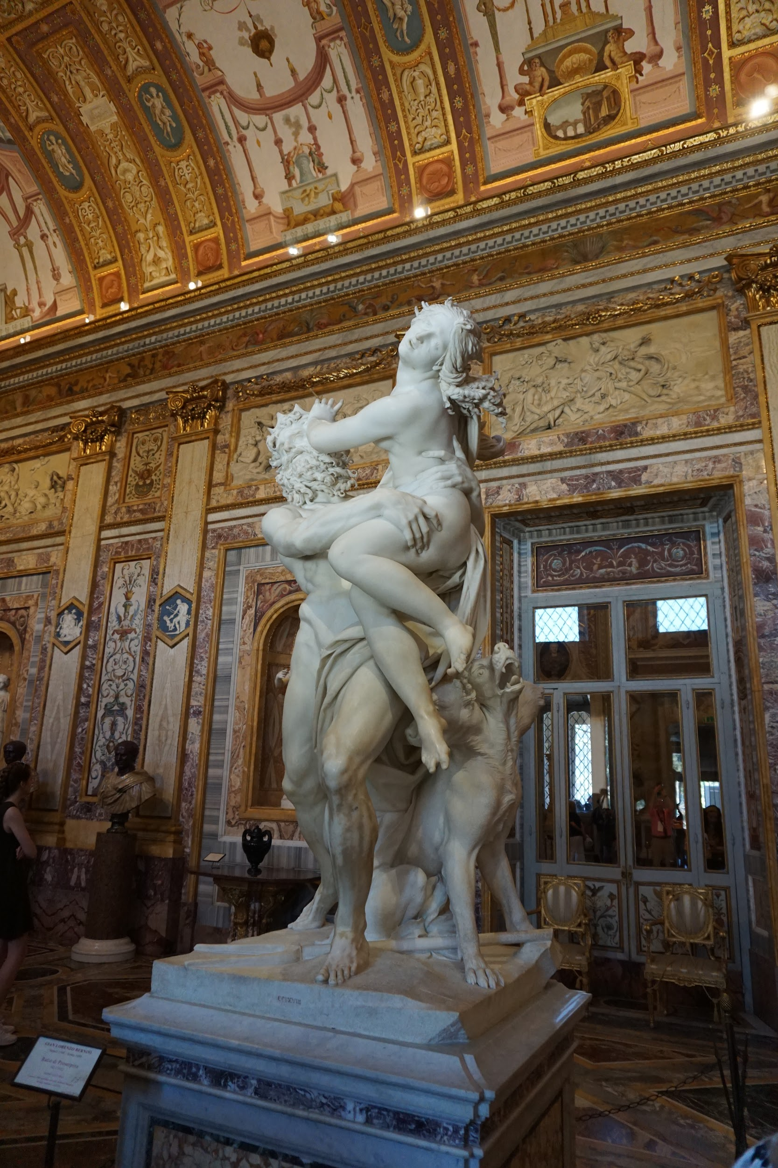
Borghese Museum
Villa Borghese
Built in the 1600s
Used to be a private villa, now owned by the Italian government

Slide 20
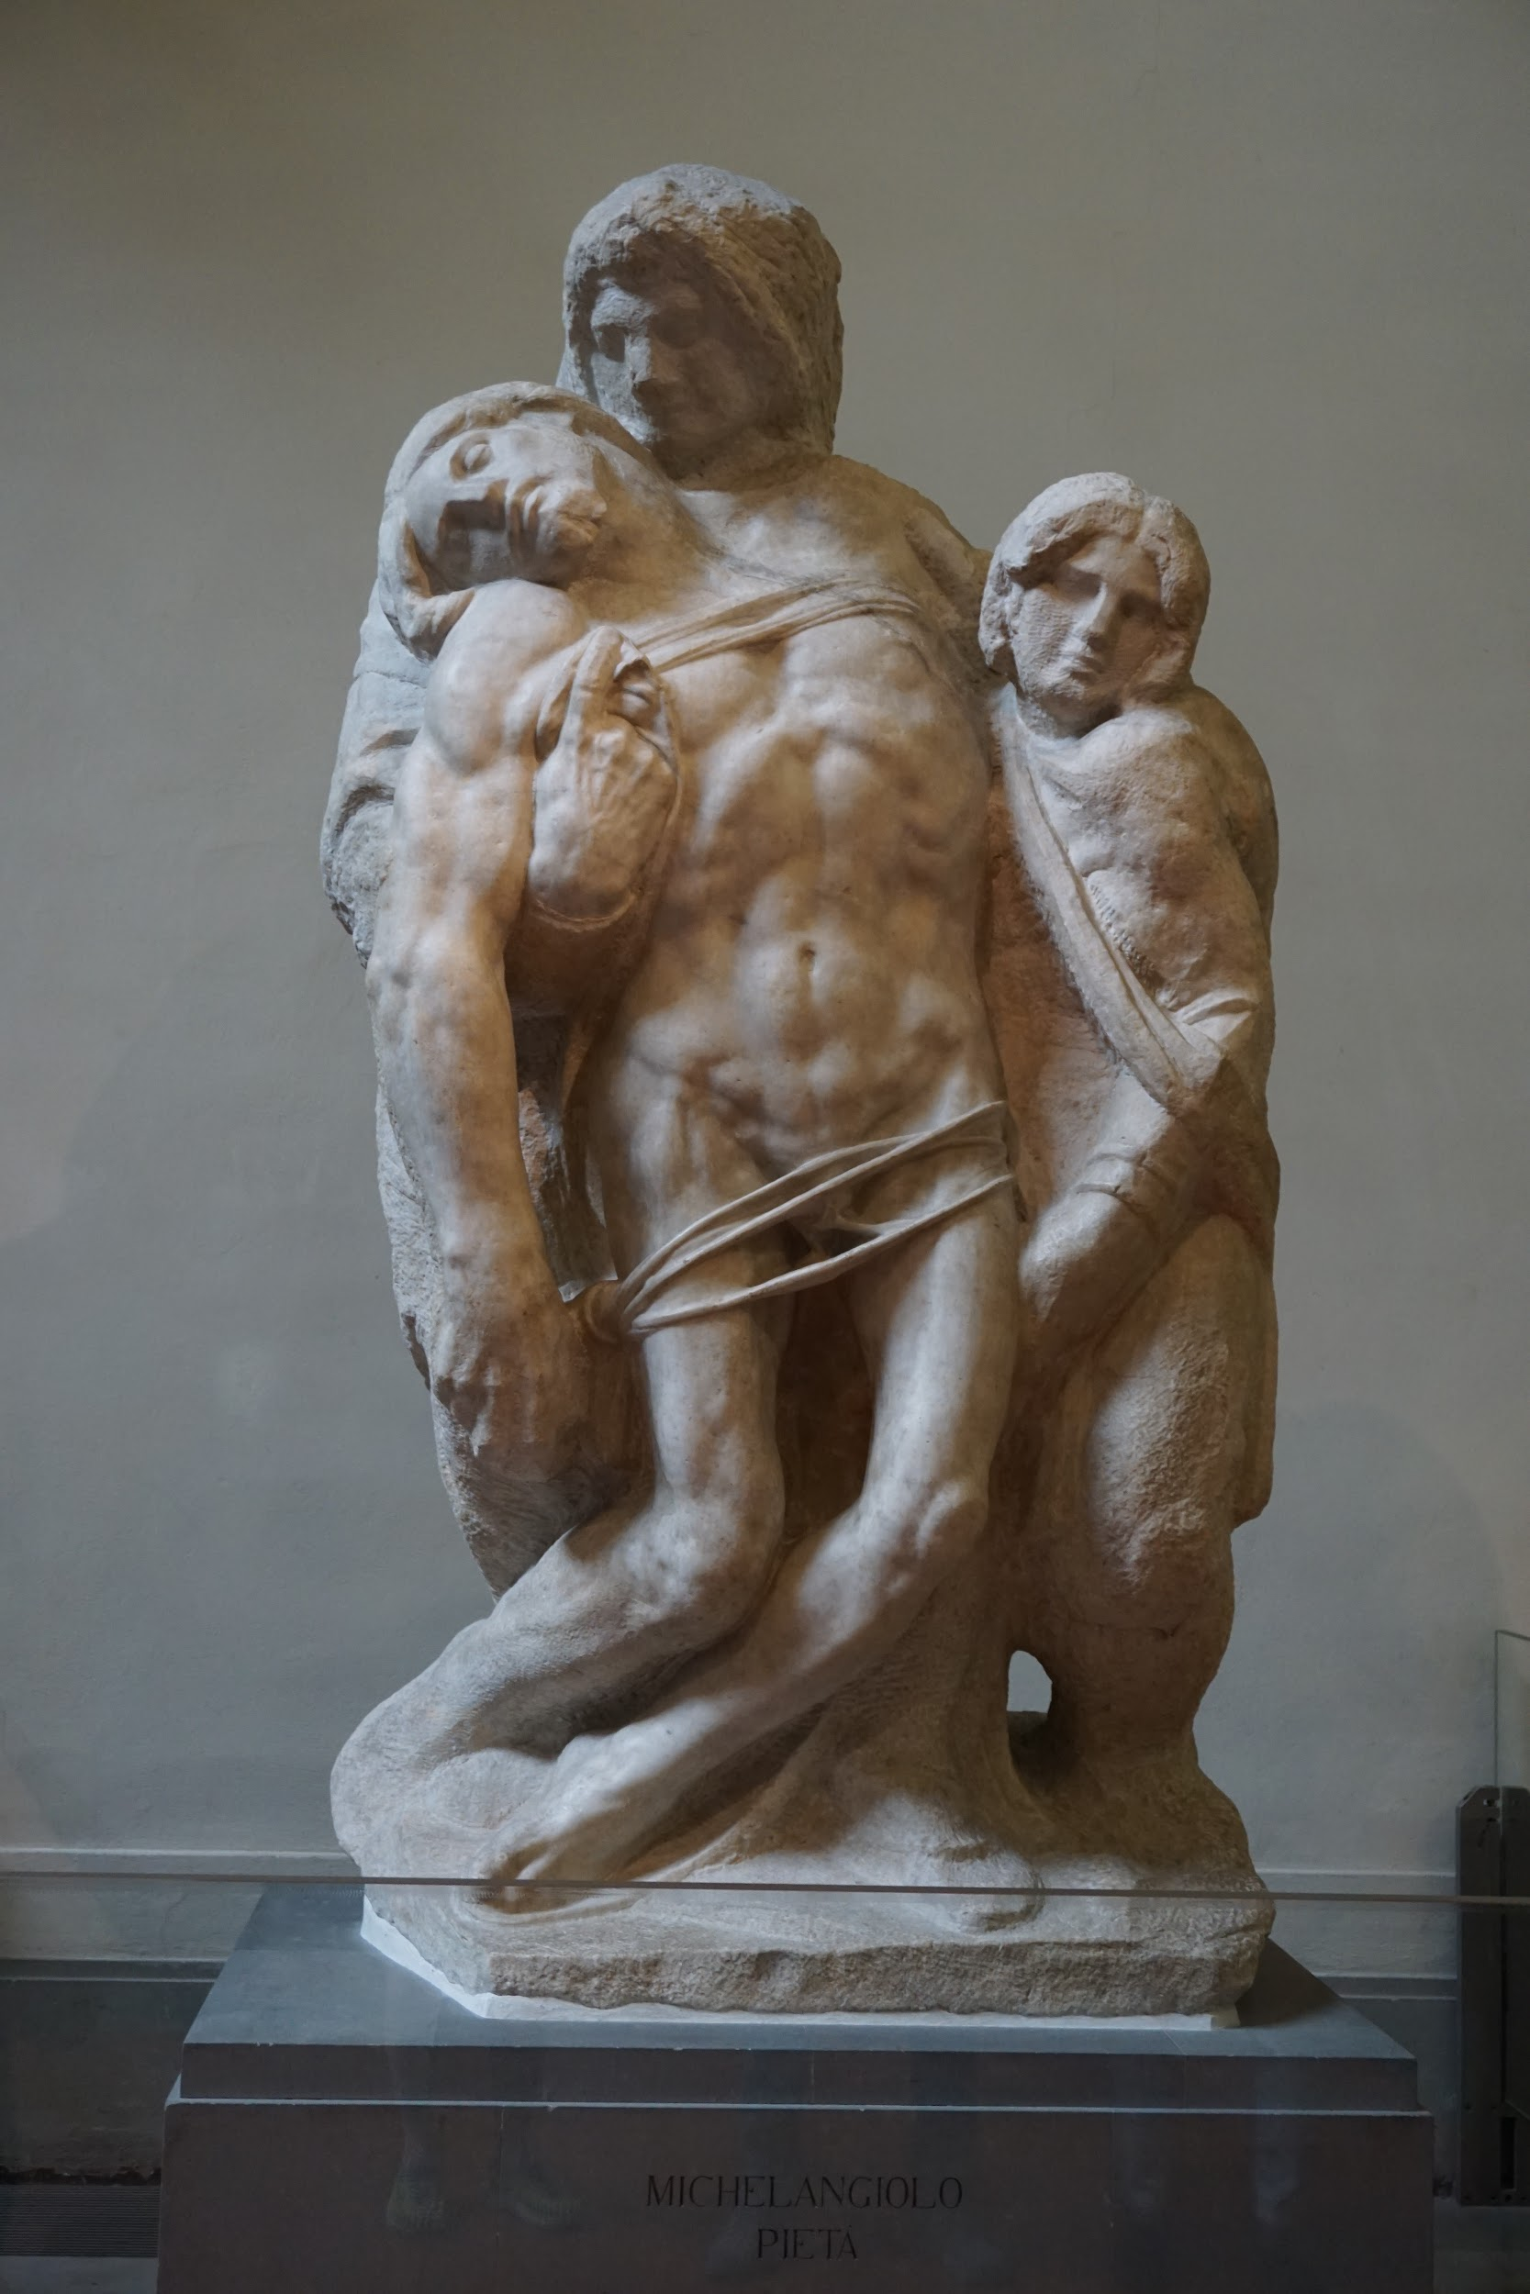
Florence
Apartment Stay
Several apartments, likely 2-3 total, divided based on gender and number of students
Highlights:
Accademia (Michelangelo’s David), Uffizi, Duomo, Pitti Palace and Boboli Gardens.
Optional extras
Designer outlet mall
Ristorante Natalino
Cafe Ditta Artigianale
City market, leather market

Slide 21
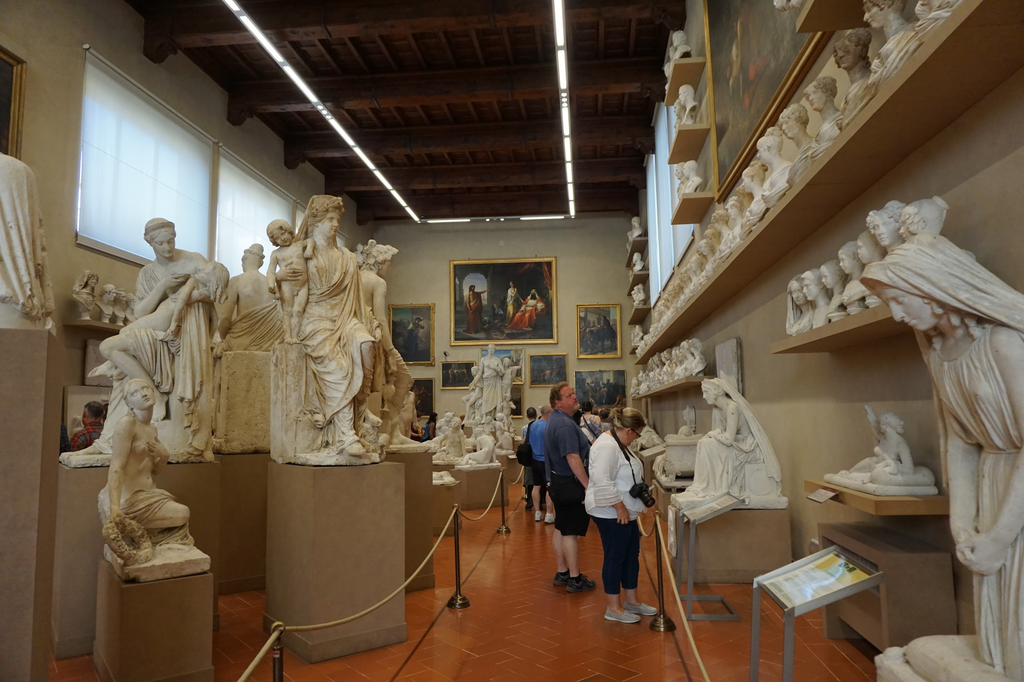
Florence
Lovely walkable city with a less ‘touristy’ and more ‘Italian’ atmosphere.
The Arno river
The heart of the Renaissance!

Slide 22
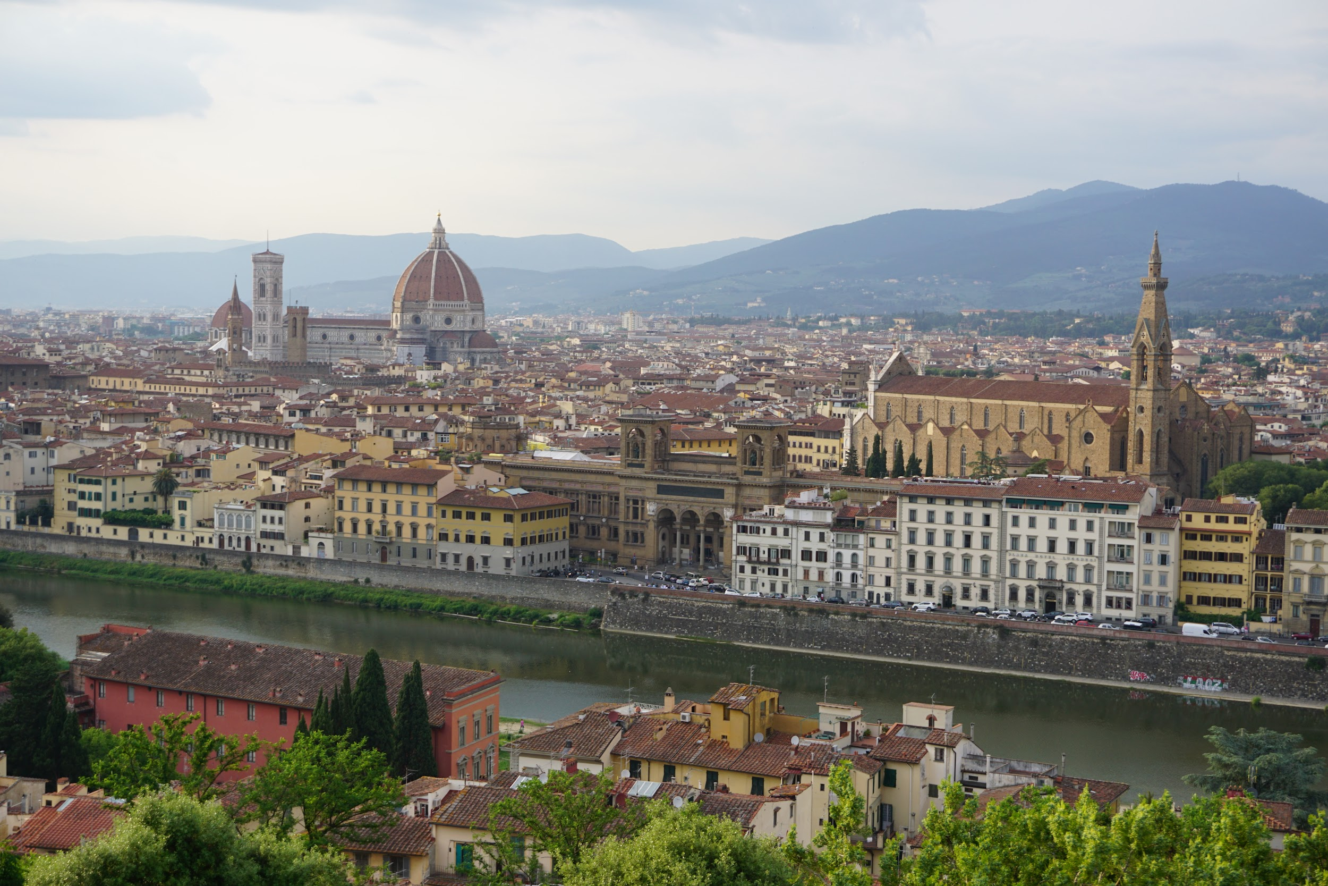
View over Florence from Piazza Michelangelo

Slide 23
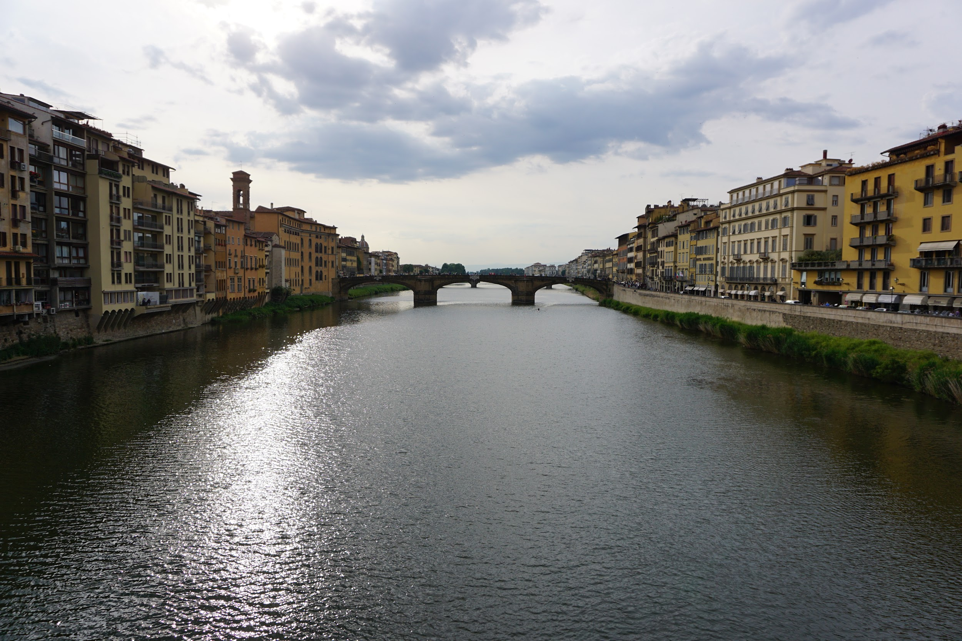
The Arno River

Slide 24
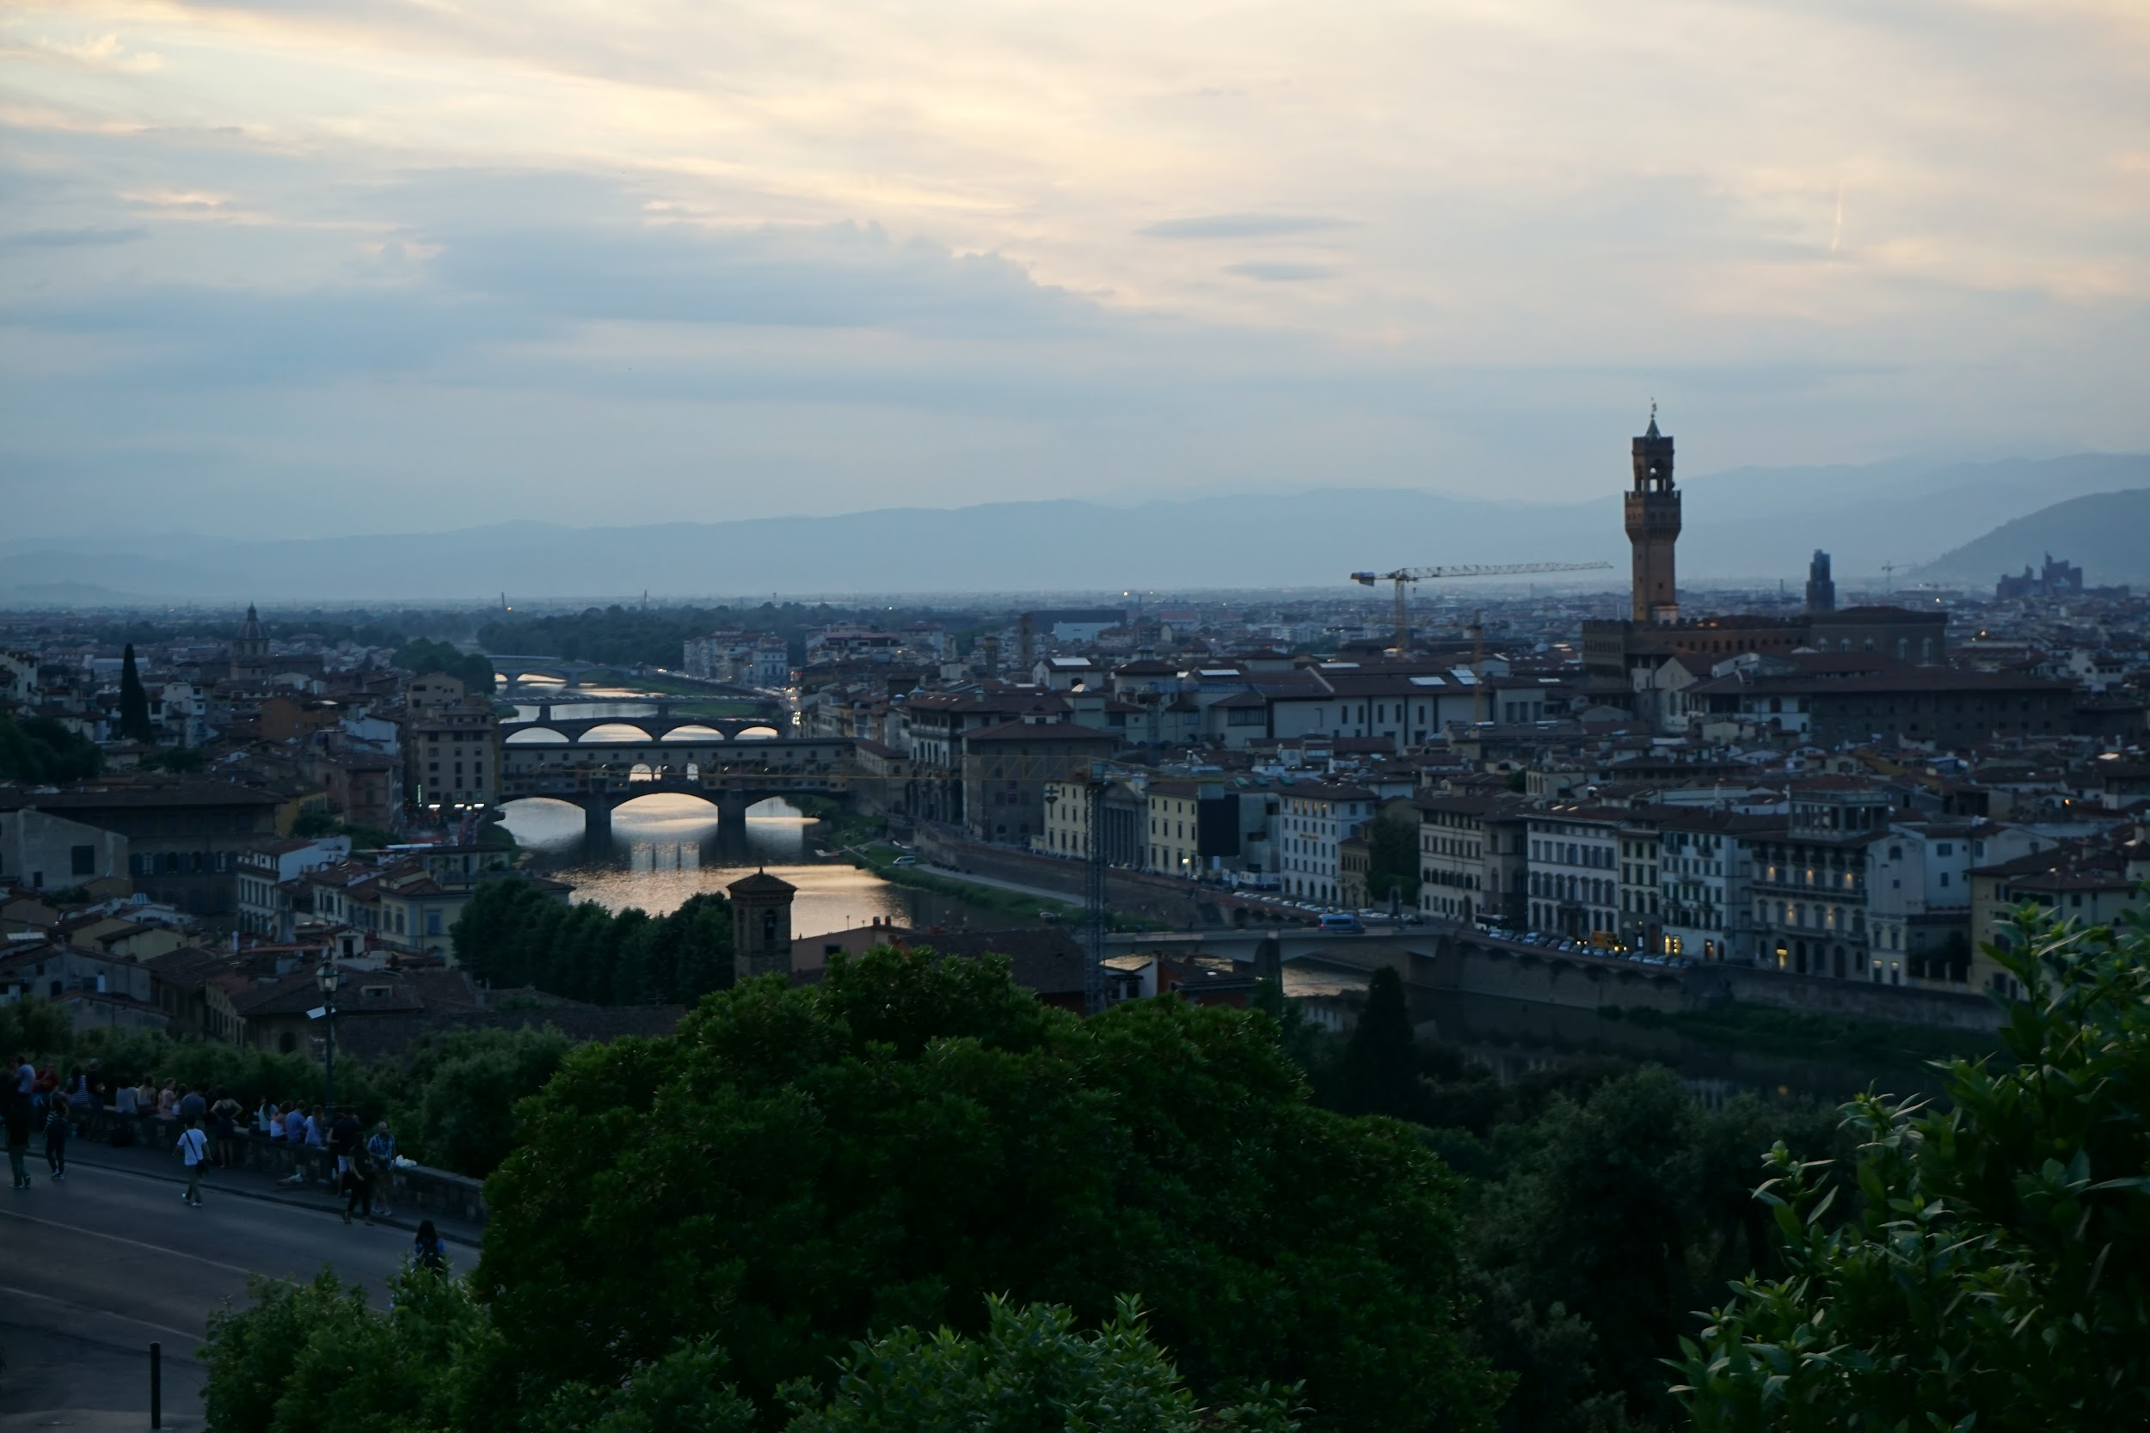
Sunset over Florence

Slide 25
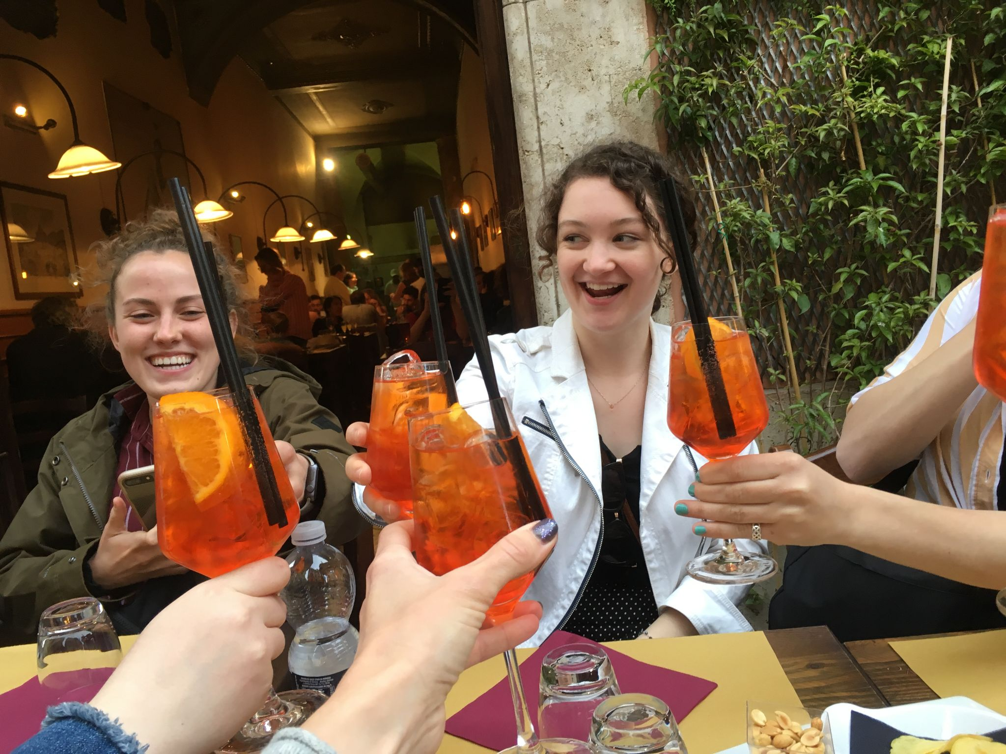

Slide 26
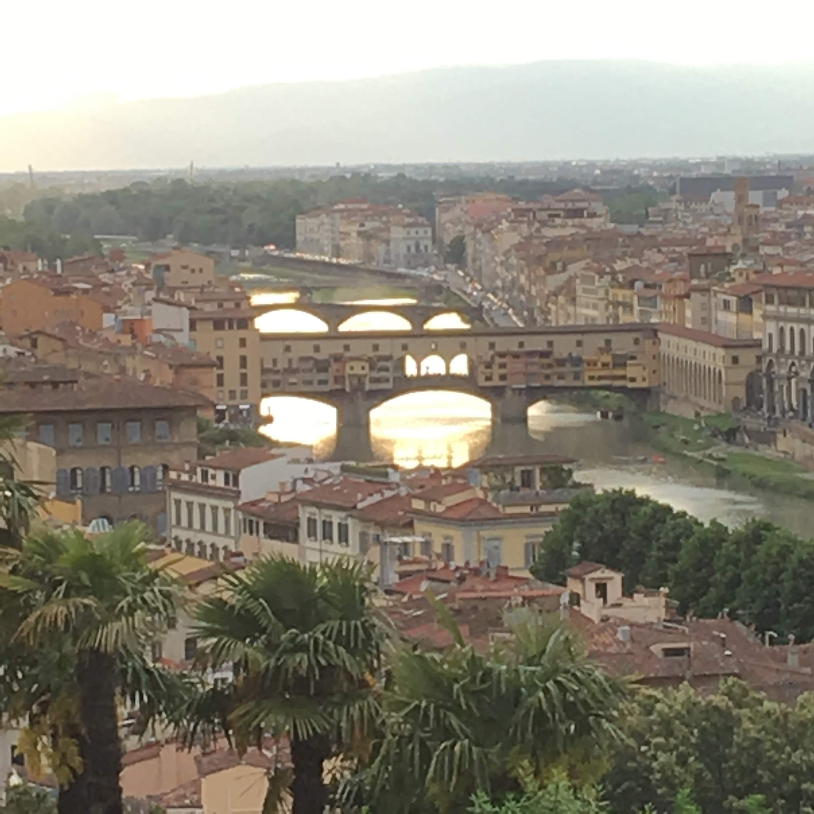
Ponte Vecchio from Piazza Michelangelo

Slide 27
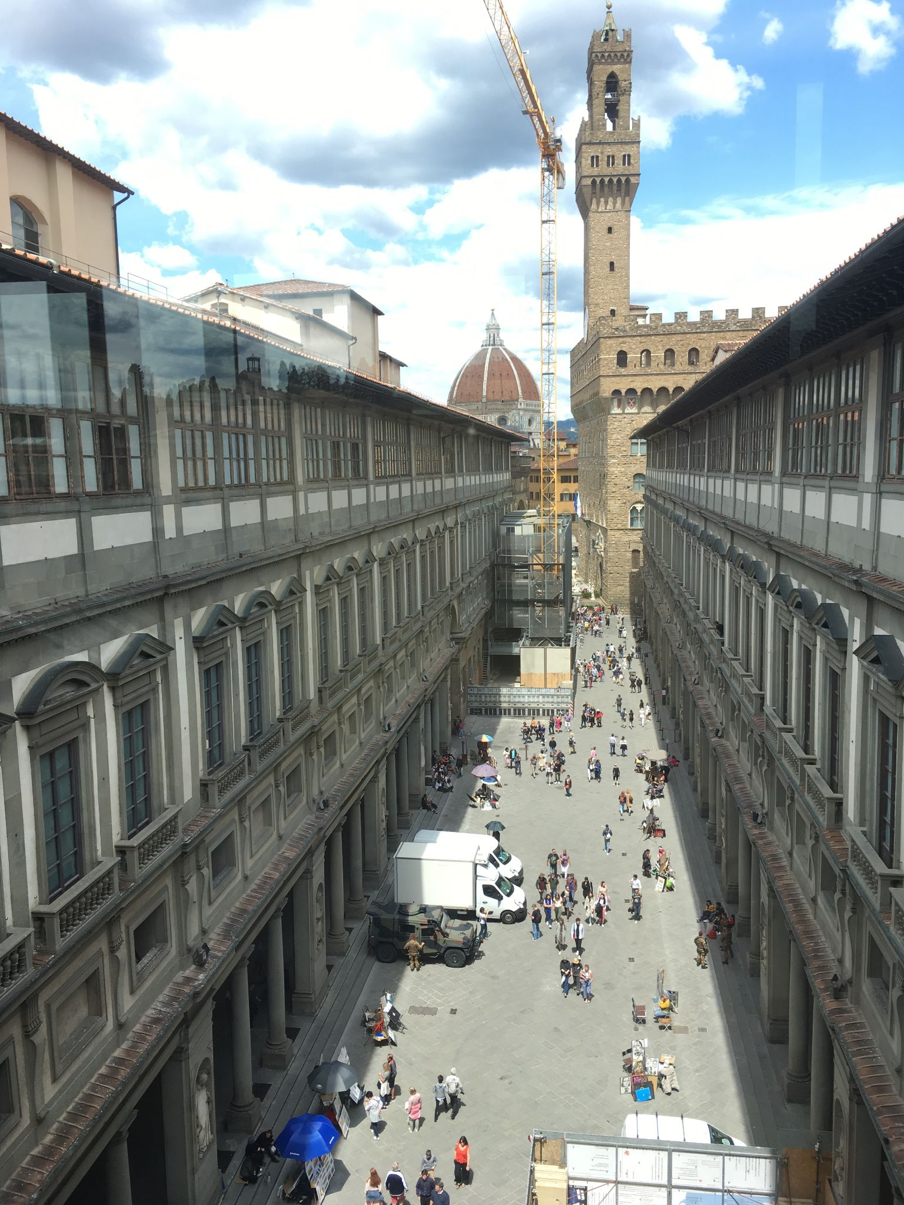

Slide 28
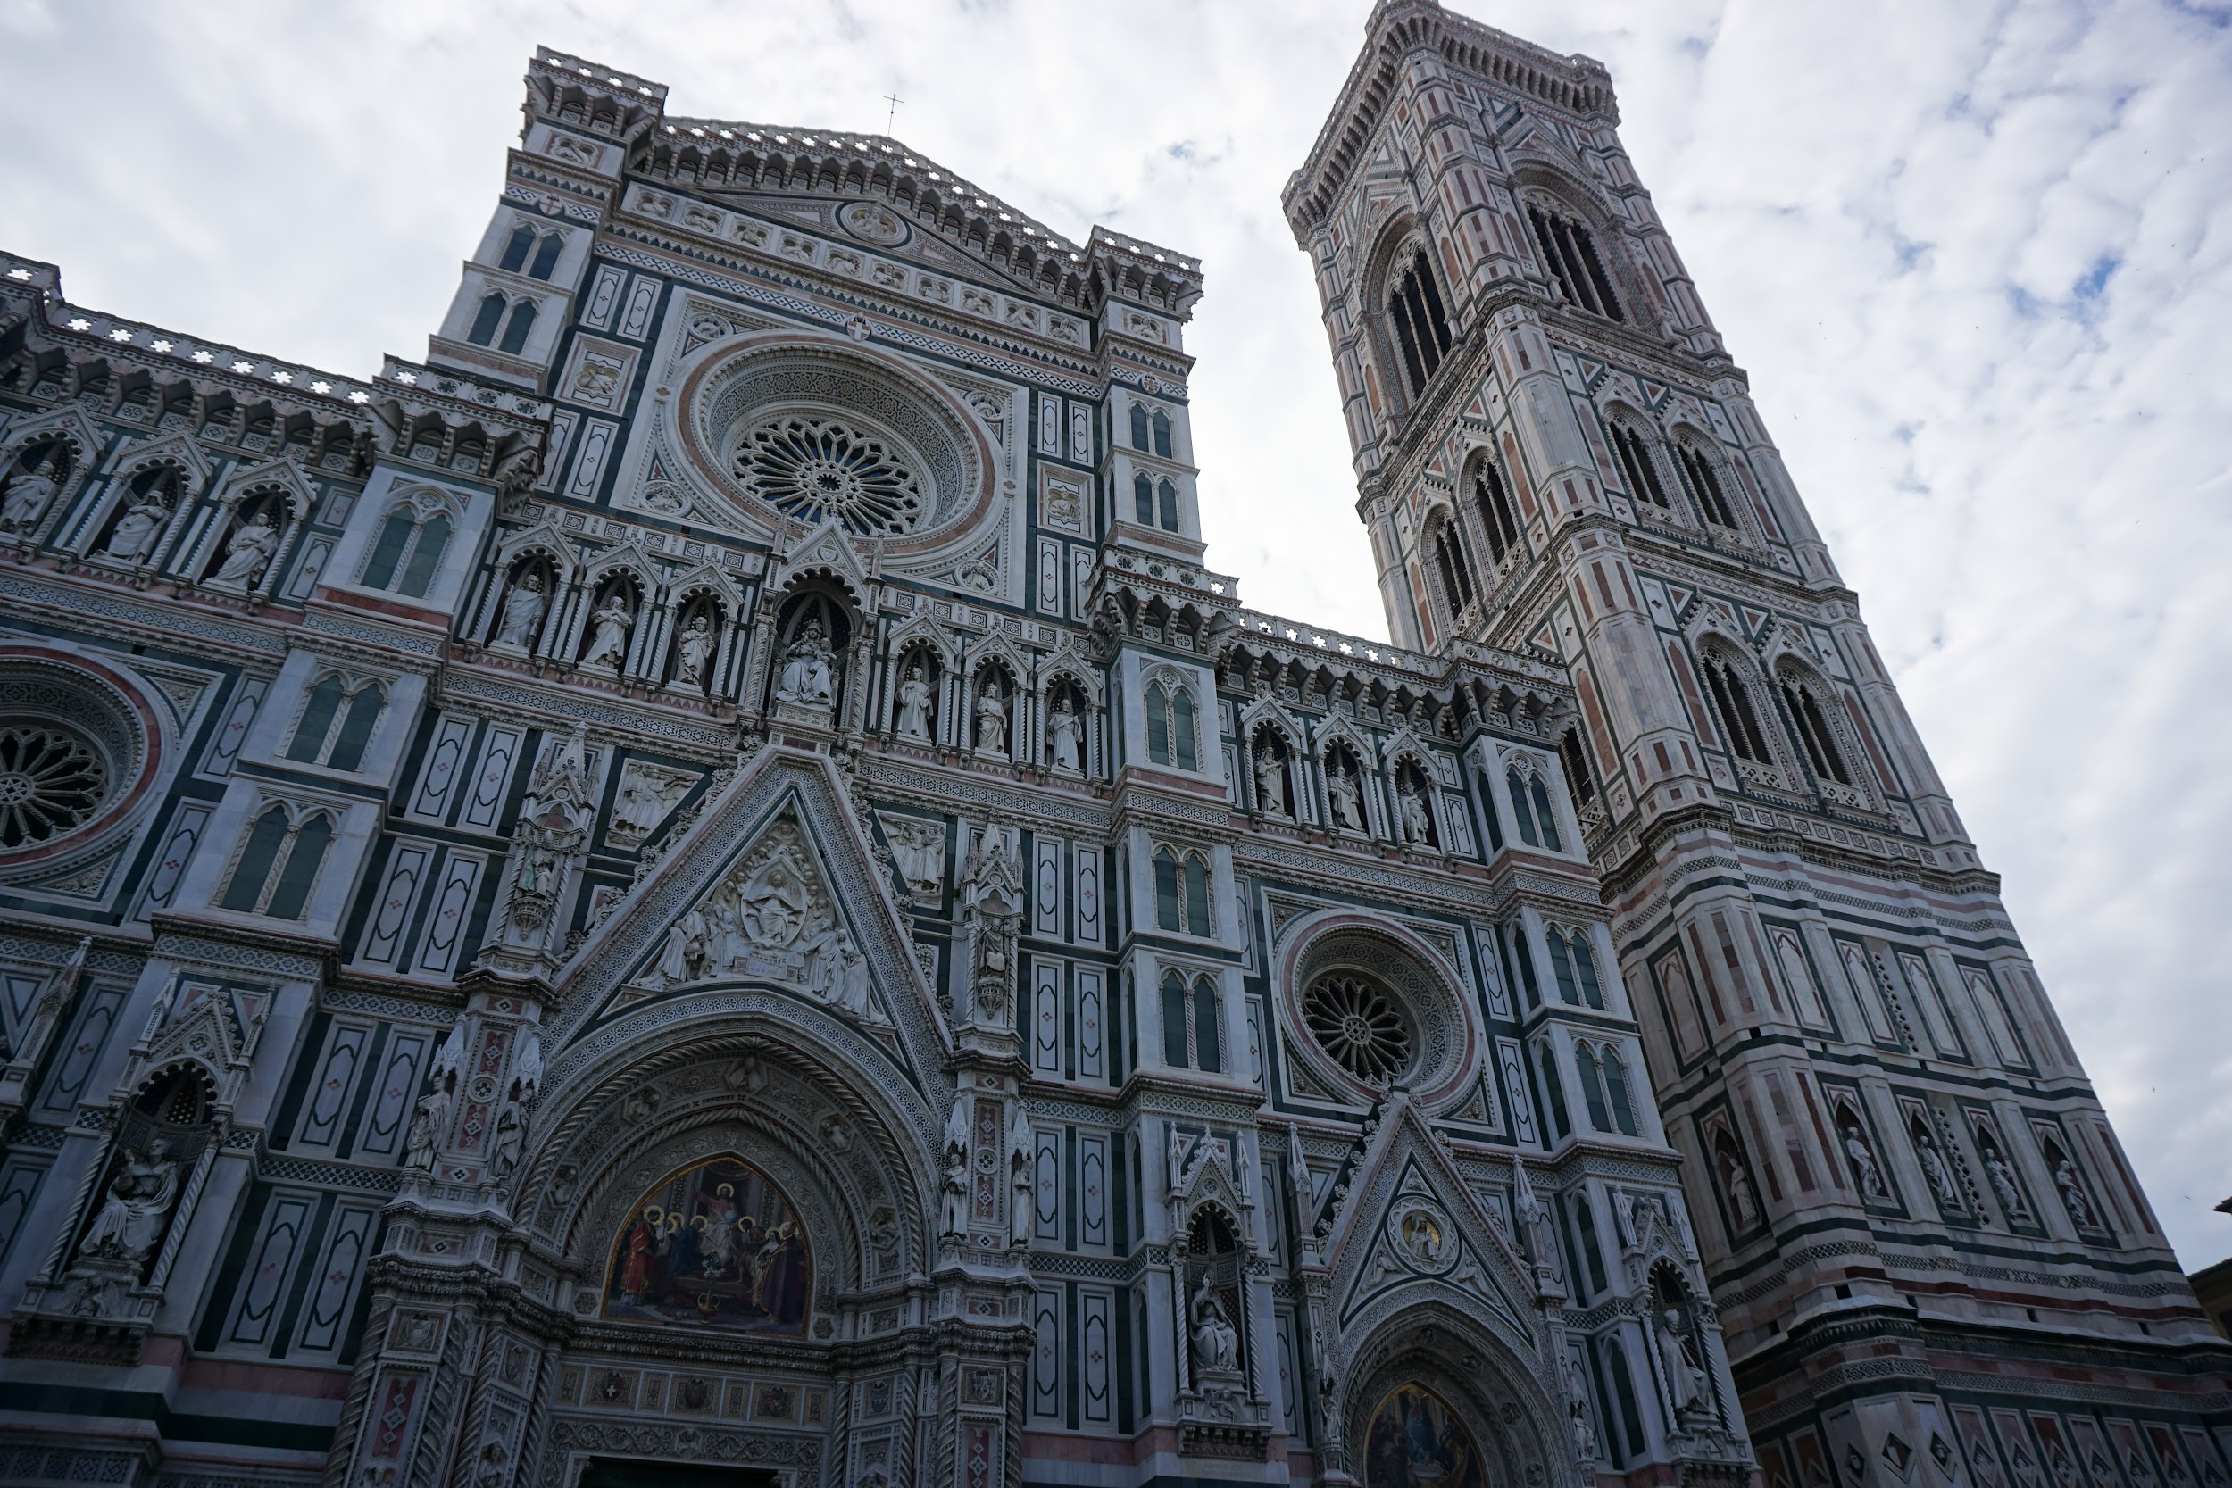
Florence’s Duomo

Slide 29
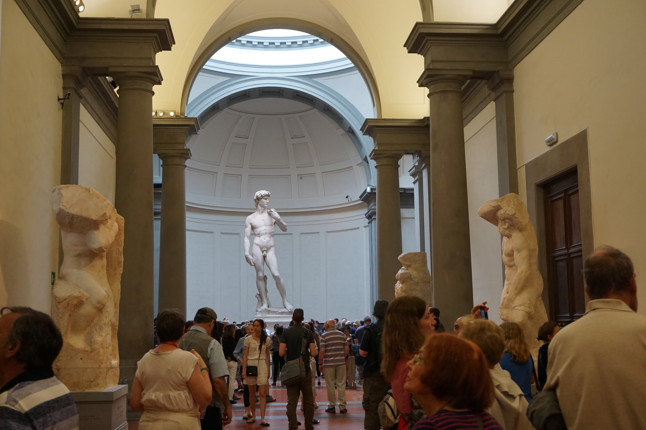
Michelangelo’s David at the Accademia

Slide 30
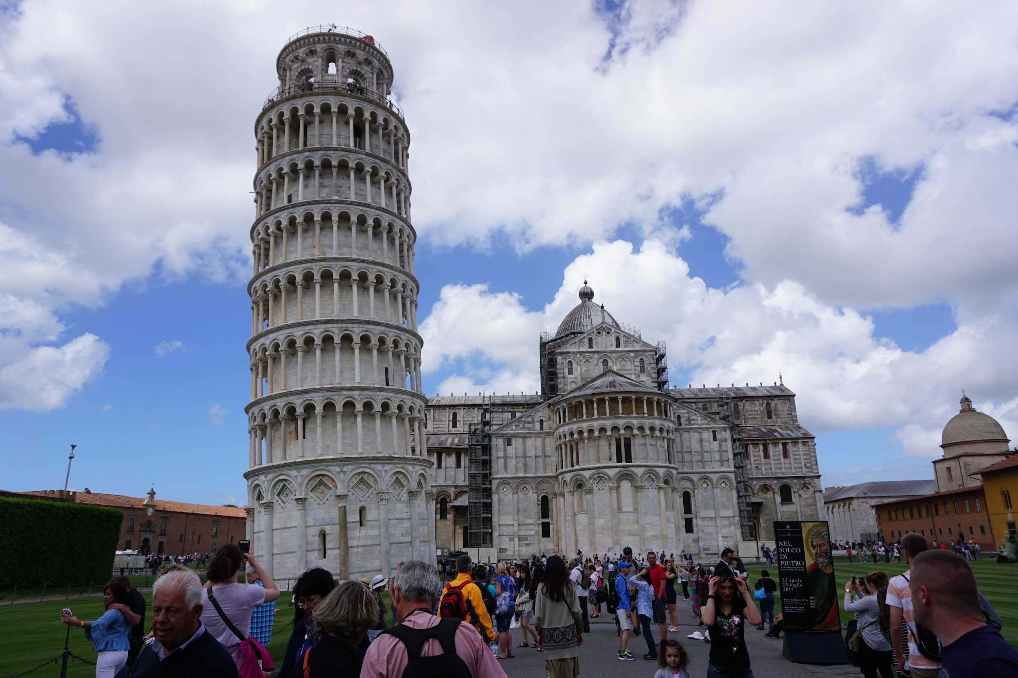
Pisa
Day trip

Slide 31
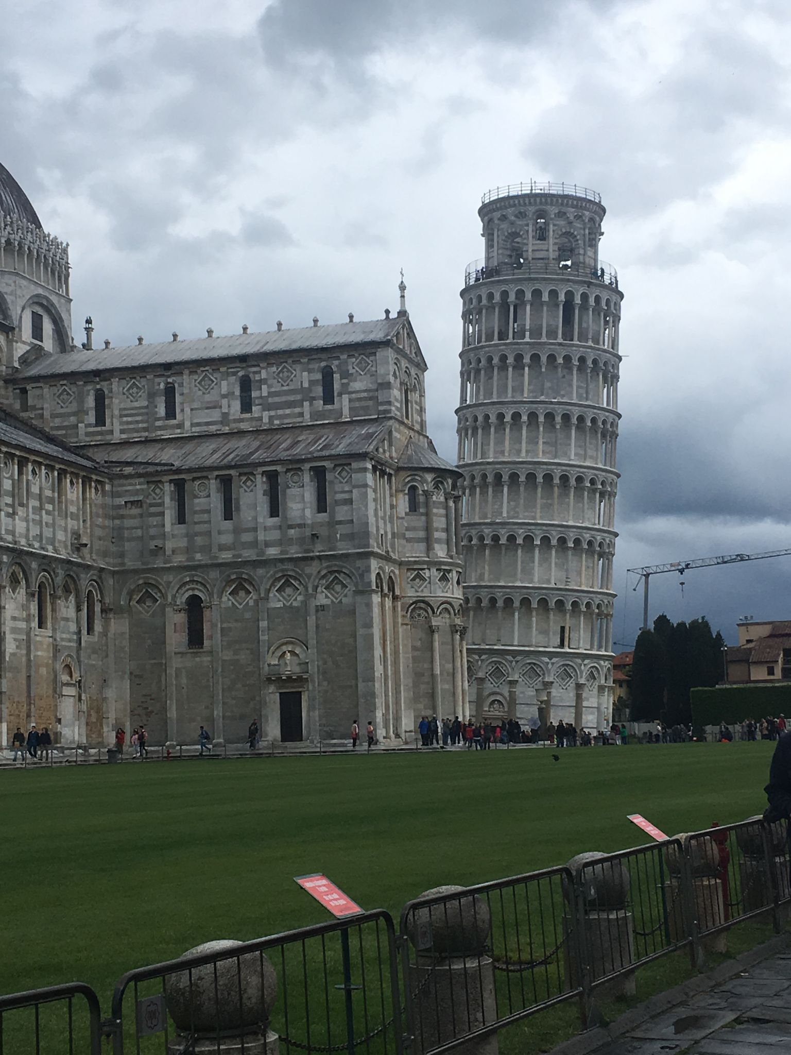

Slide 32
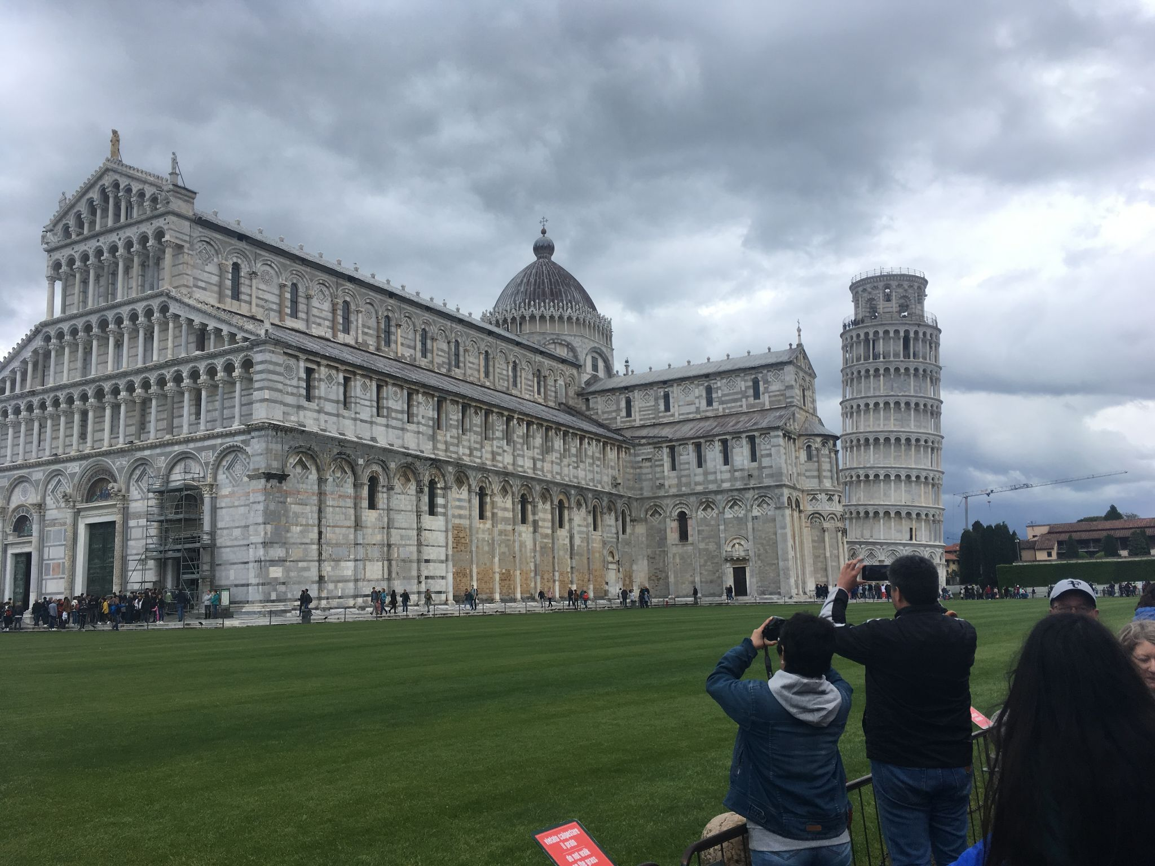

Slide 33
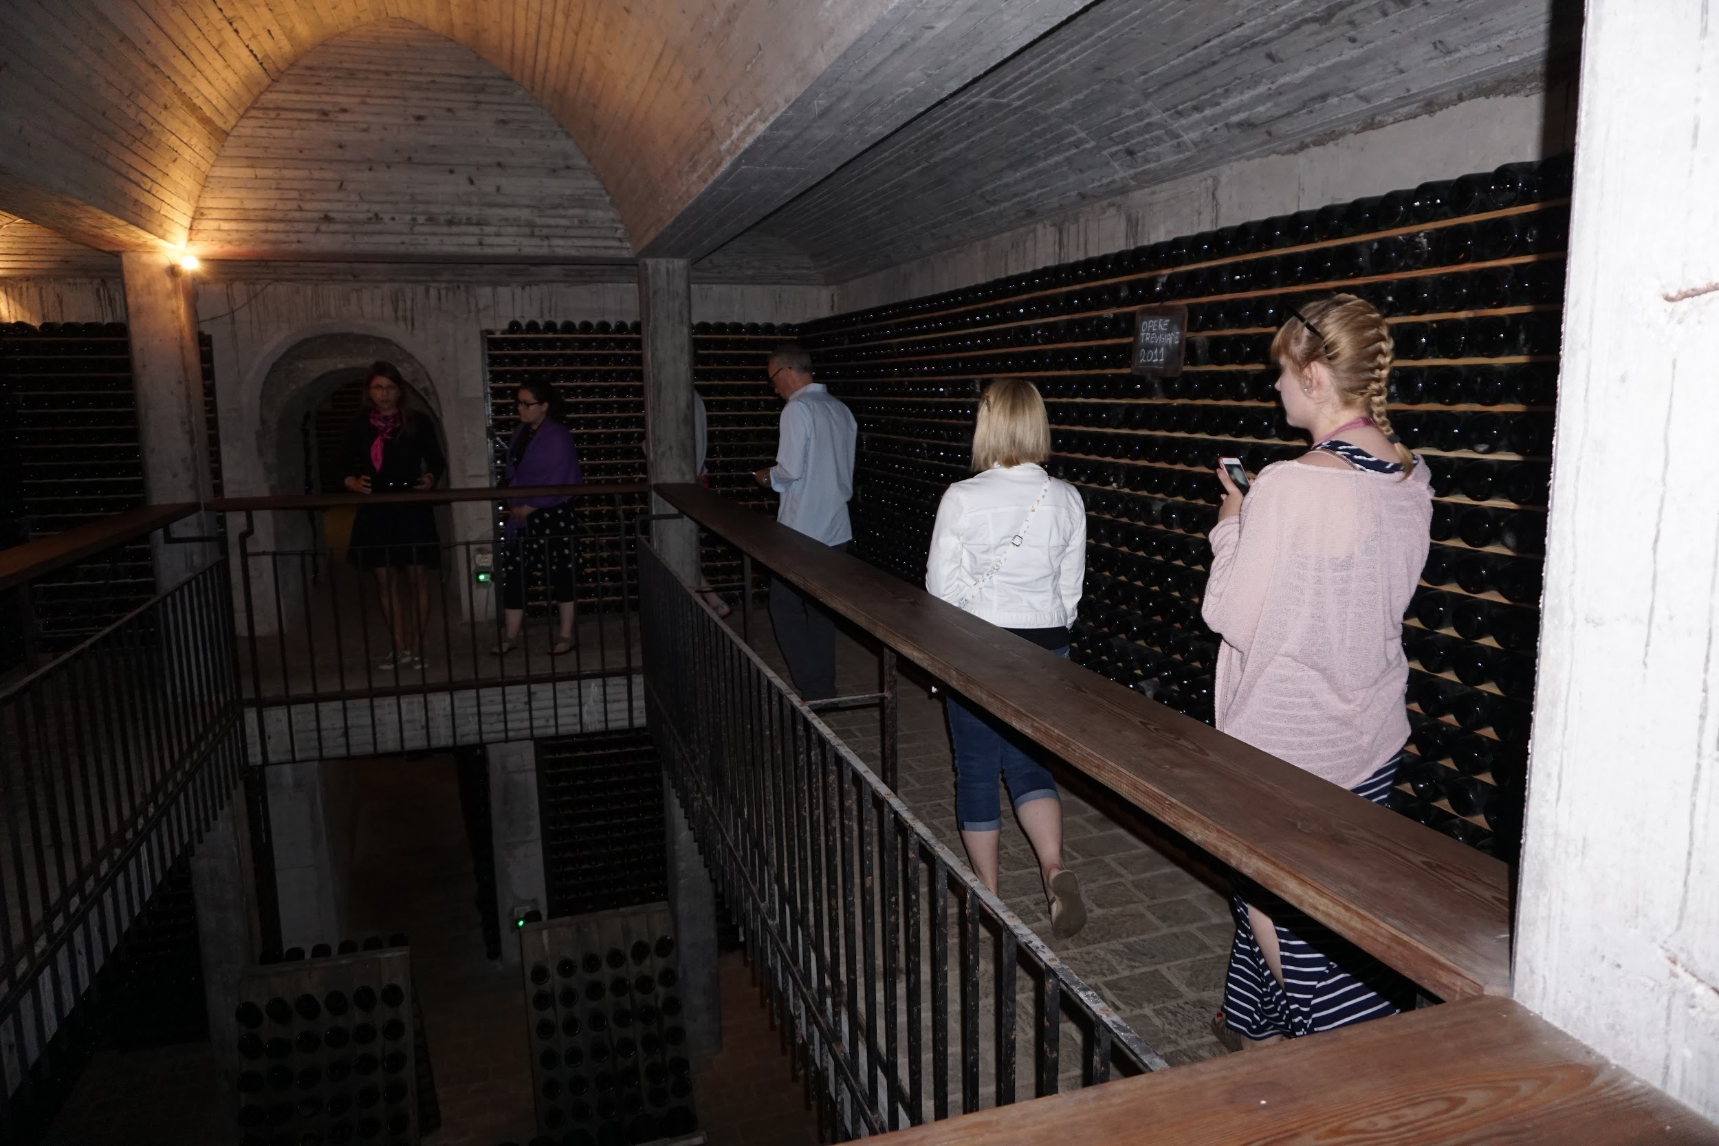
Paderno Del Grappa
Stay at a LaSallian institute (dorms)
Highlights:
Villa Sandi, Grisport, Asolo, Passagno, dai Fruts celebration dinner.
Beautiful Italian countryside
Foothills of the mountains
Well known Italian industrial area

Slide 34
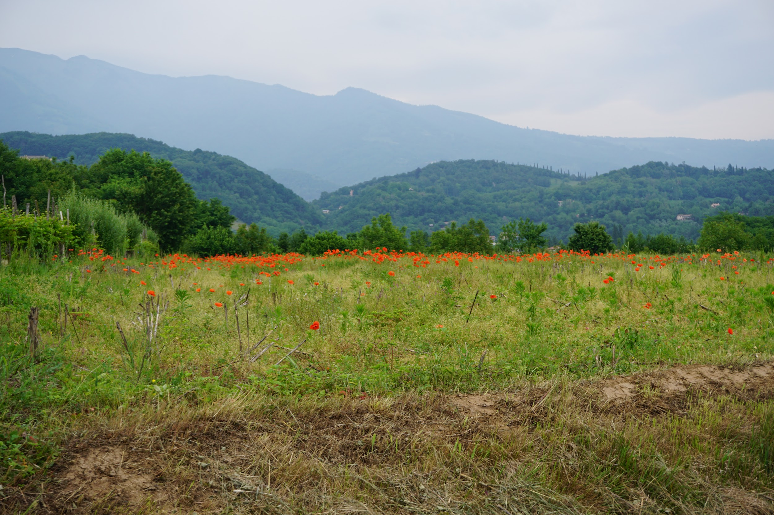

Slide 35
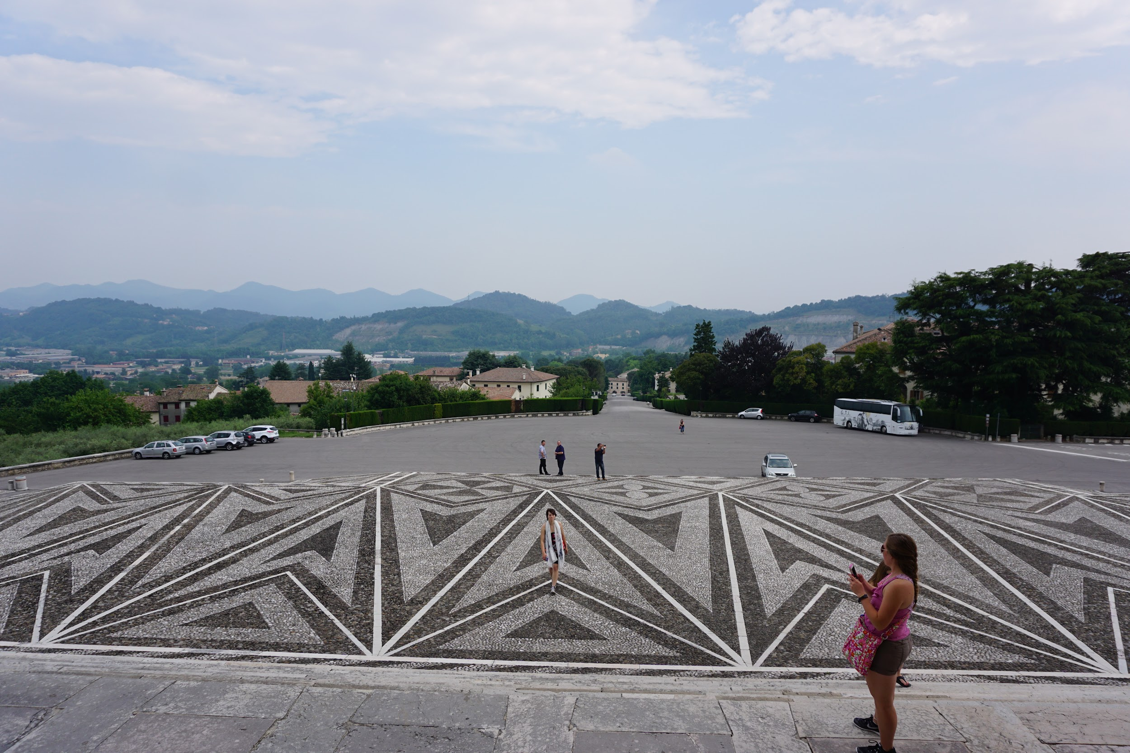

Slide 36
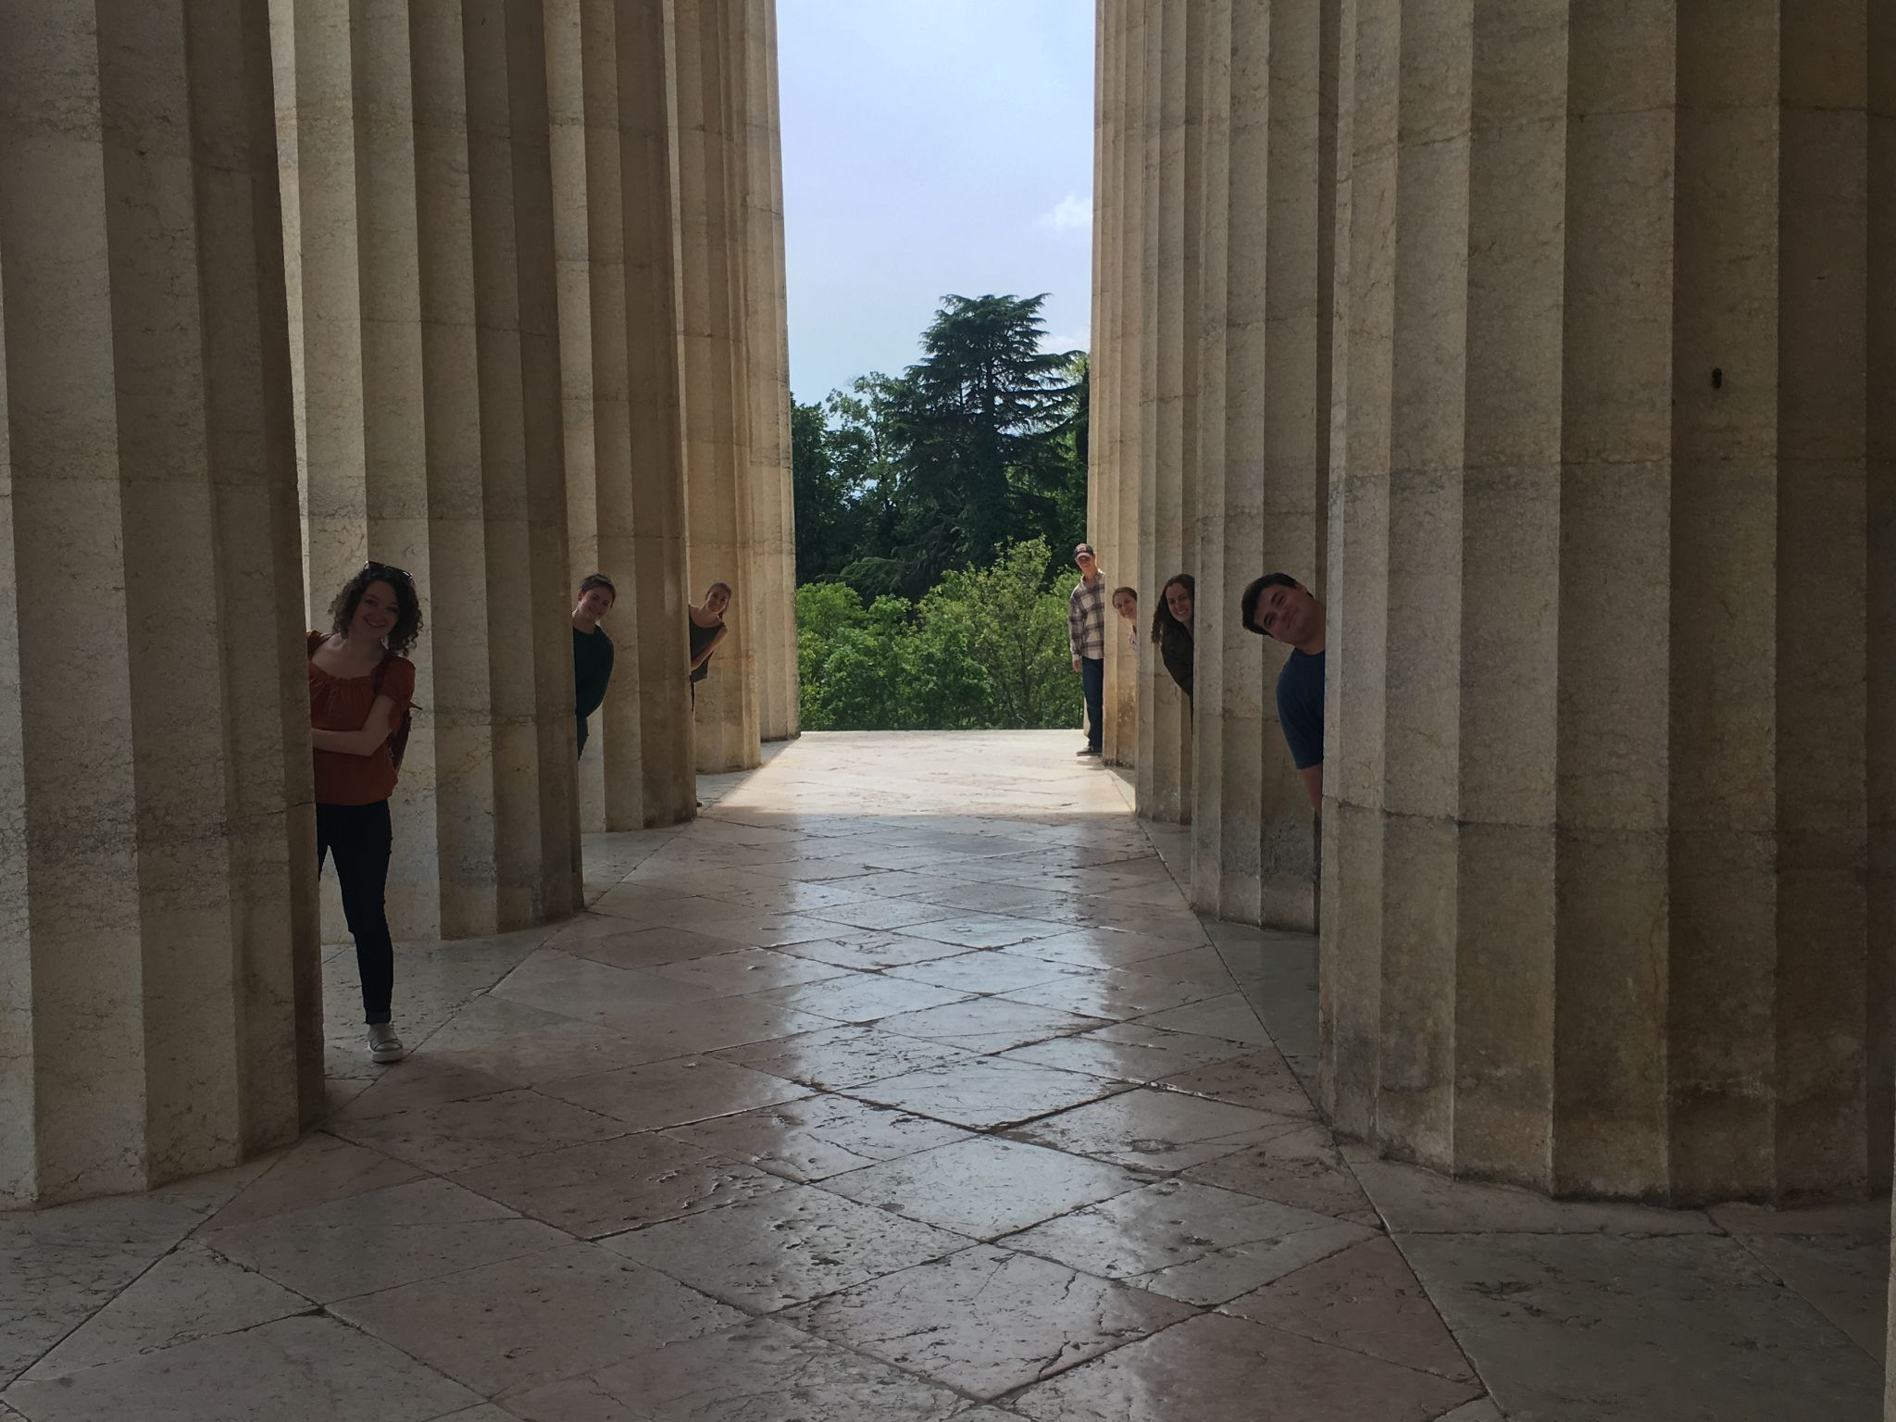

Slide 37
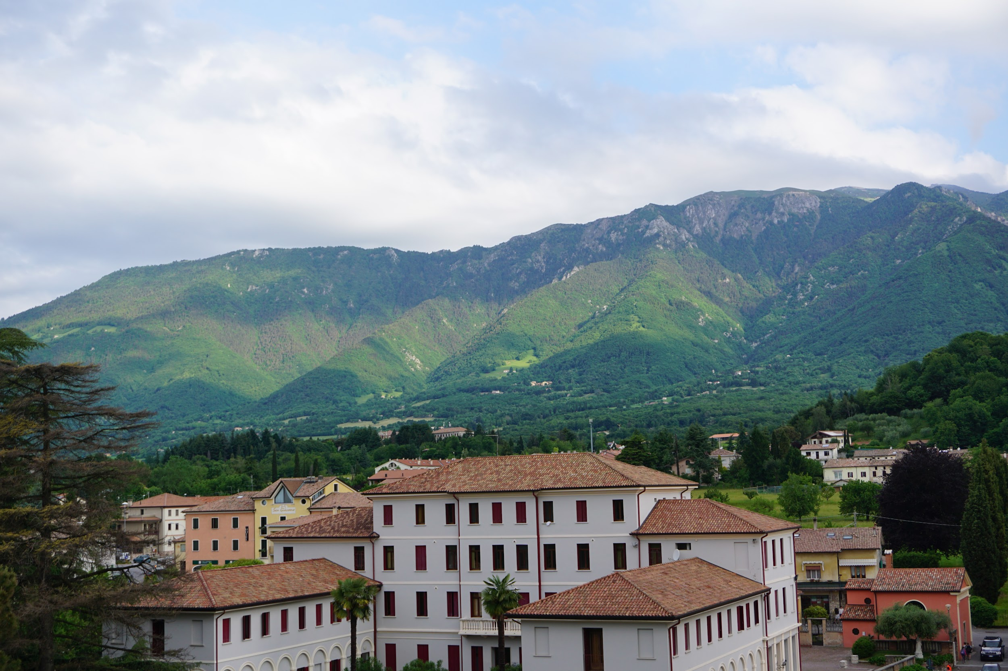

Slide 38
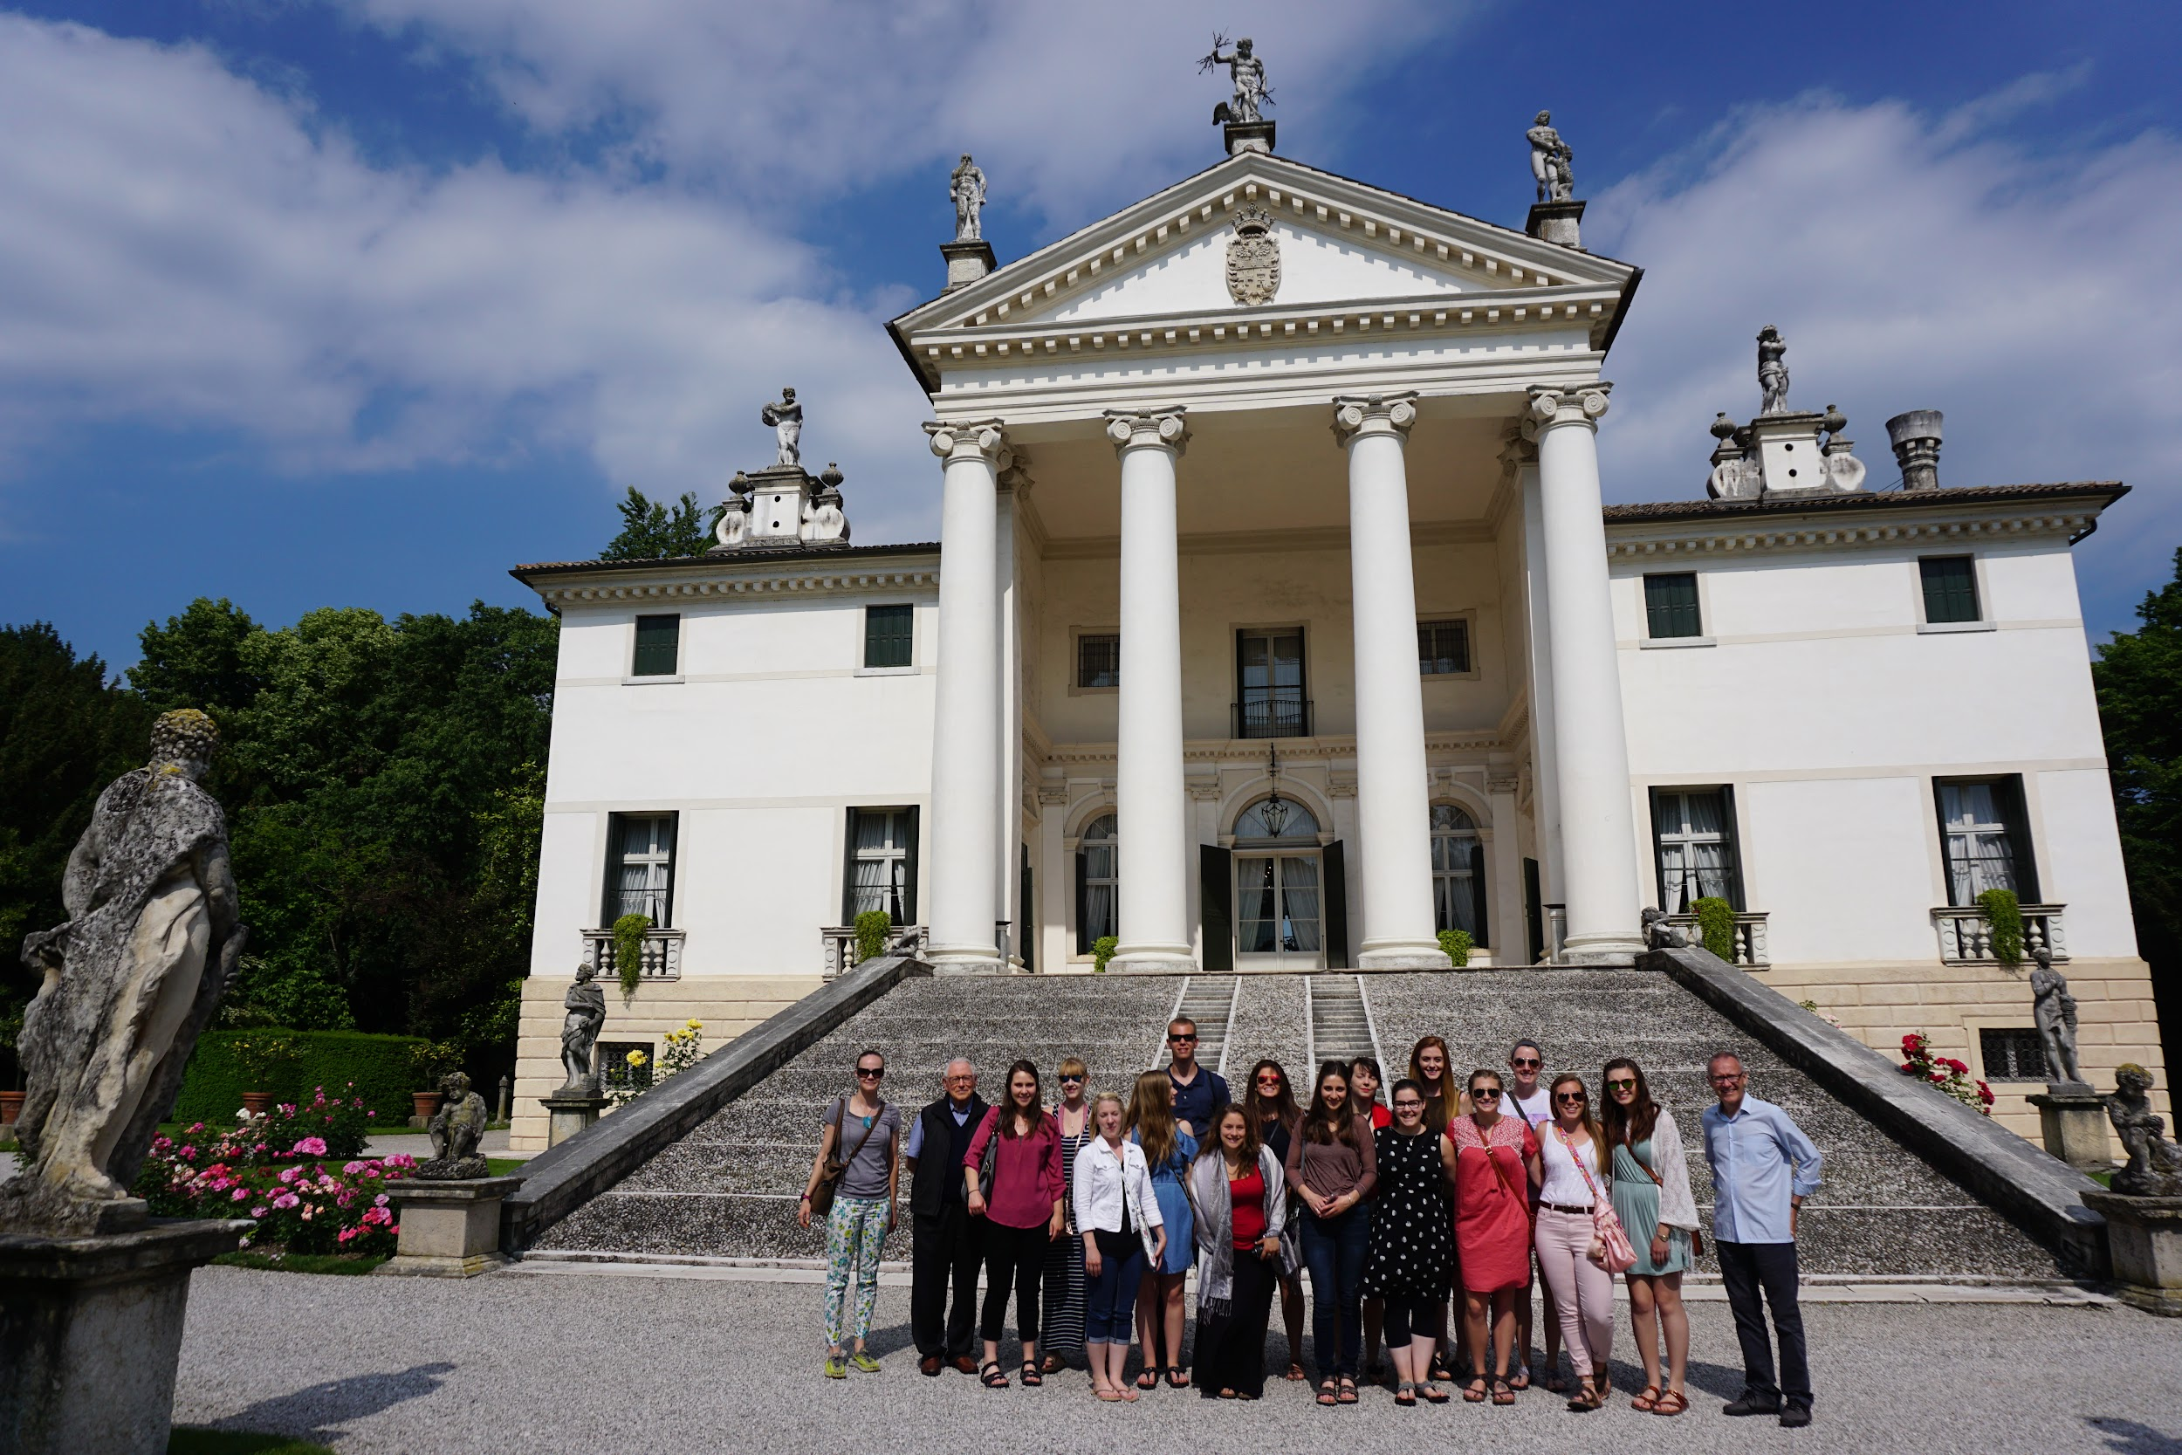

Slide 39
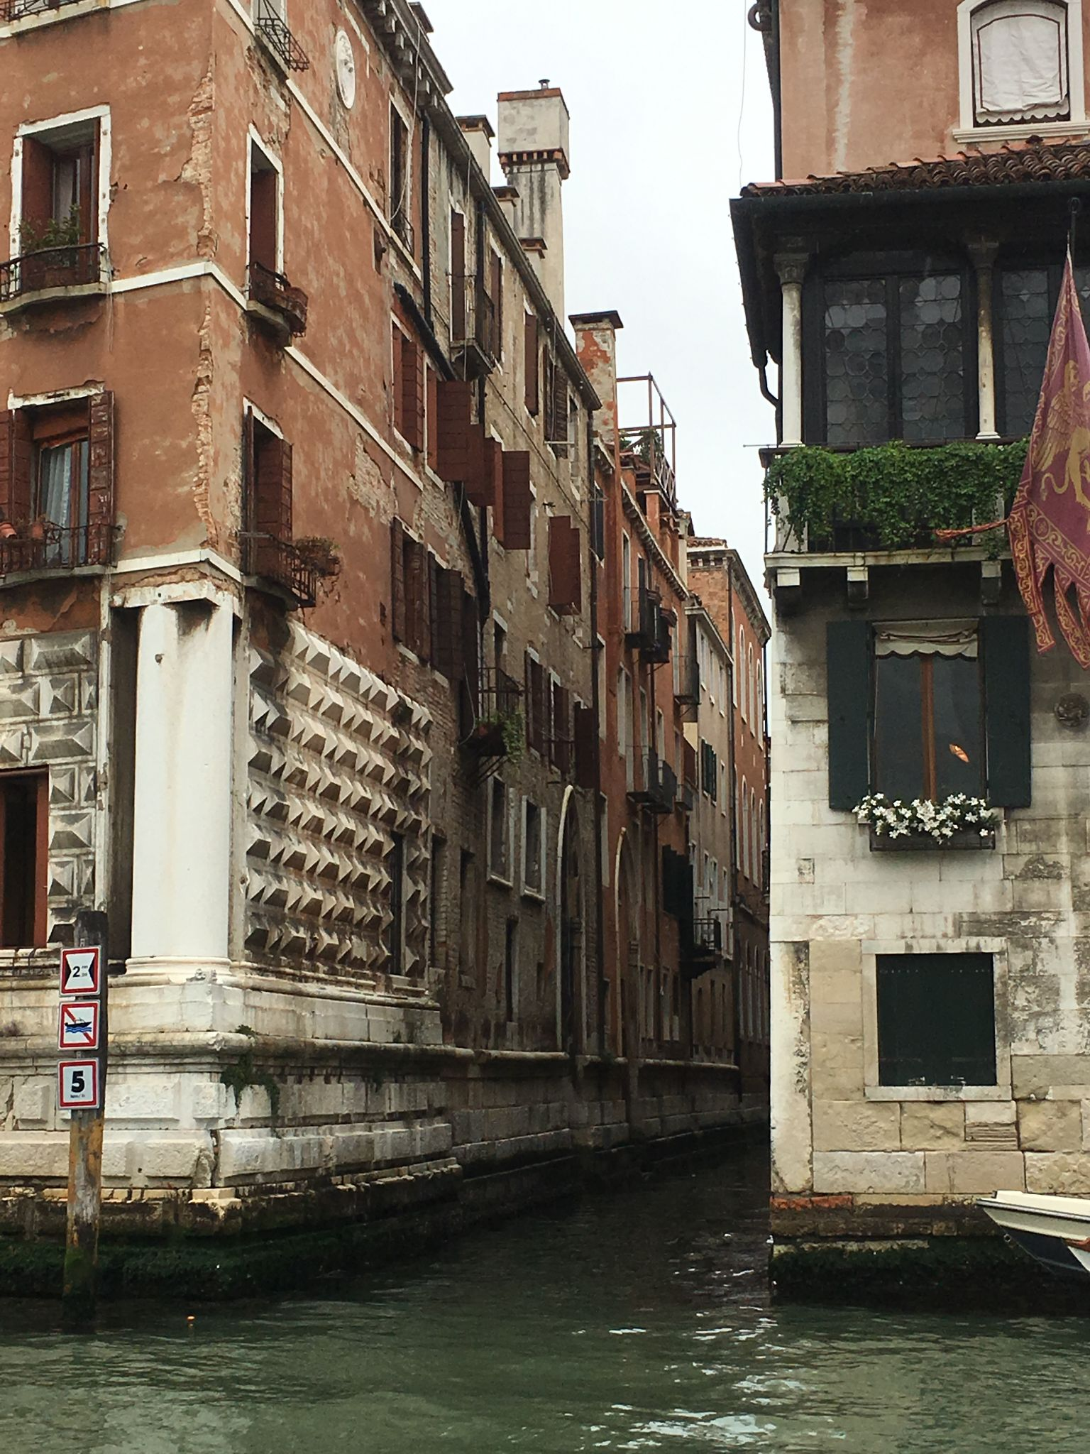
Venice
Two day trips to Venice
Highlights:
Weaving factory
St. Mark’s
Doge’s Palace

Slide 40
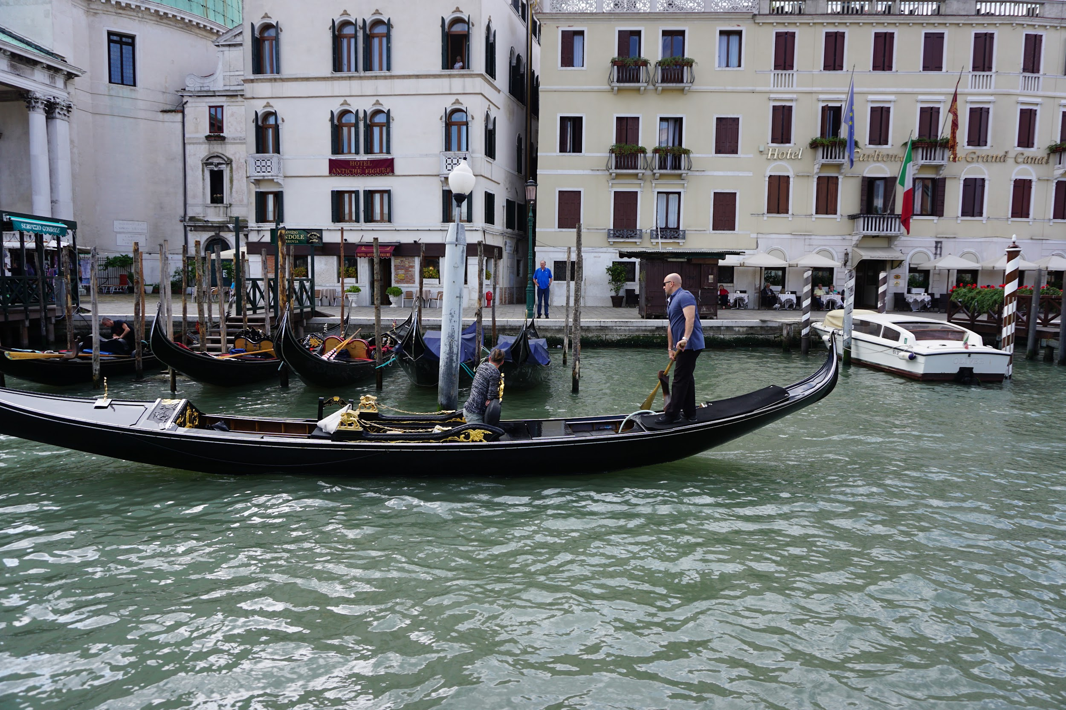

Slide 41
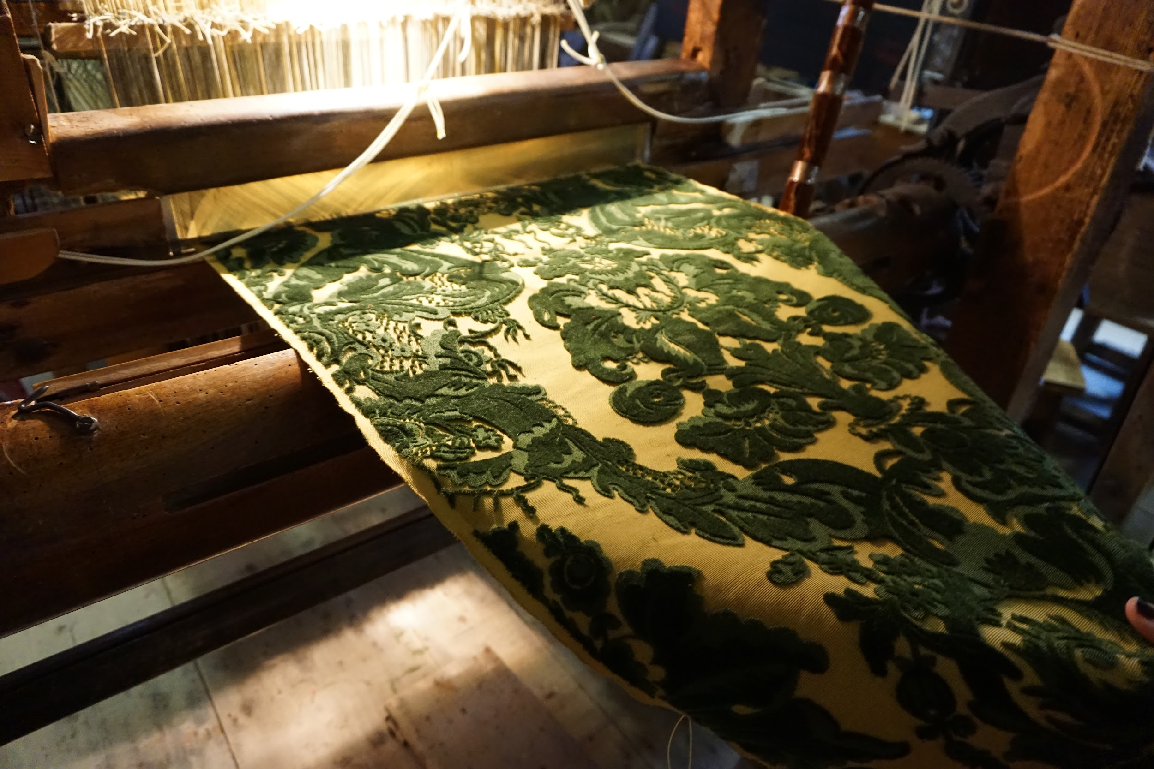

Slide 42
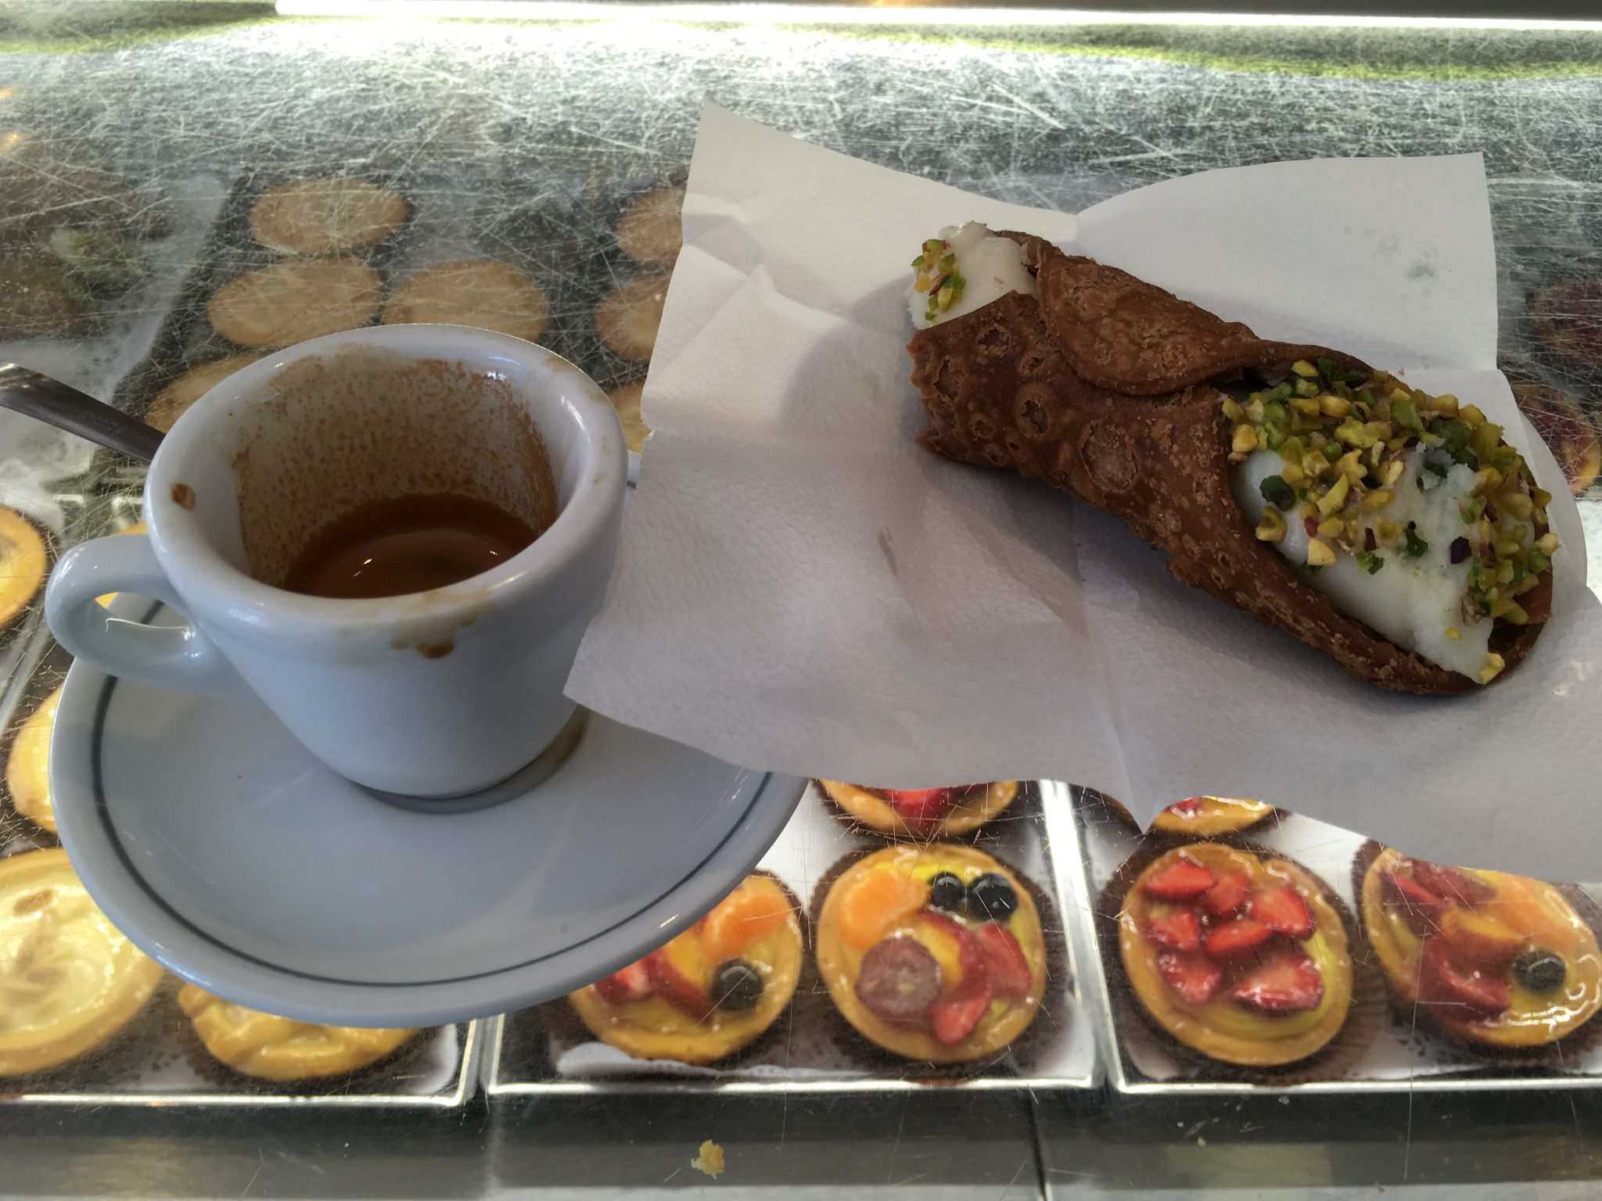
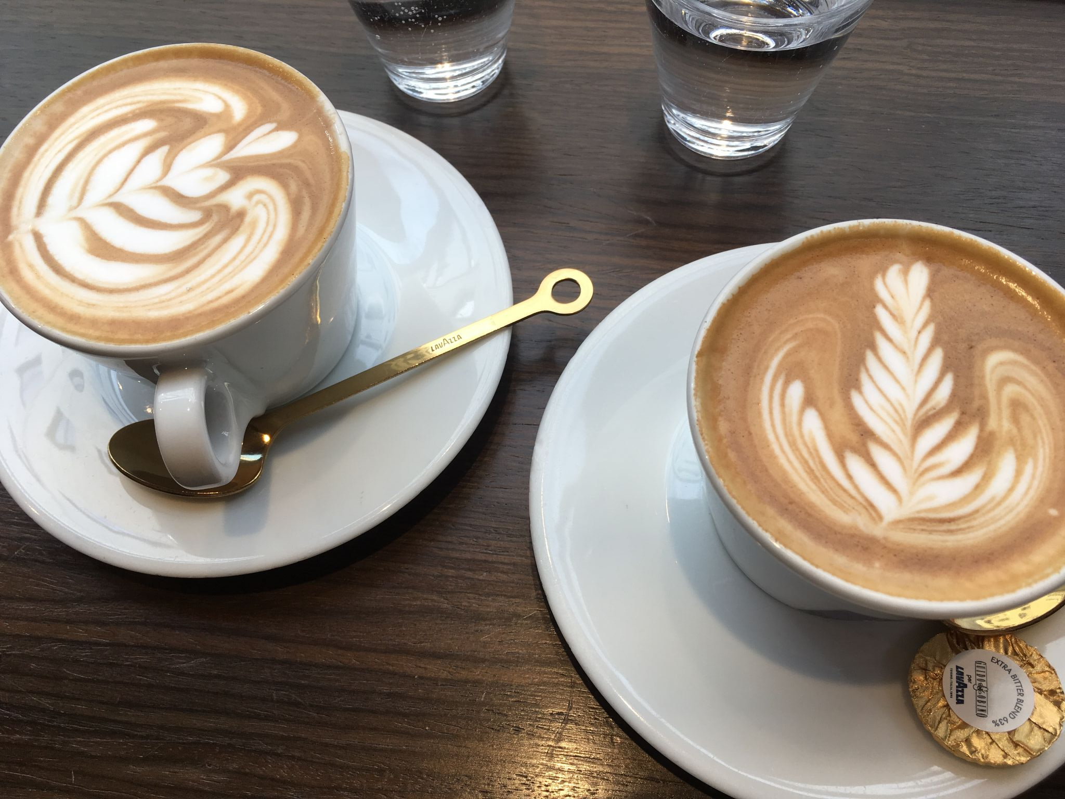

Slide 43
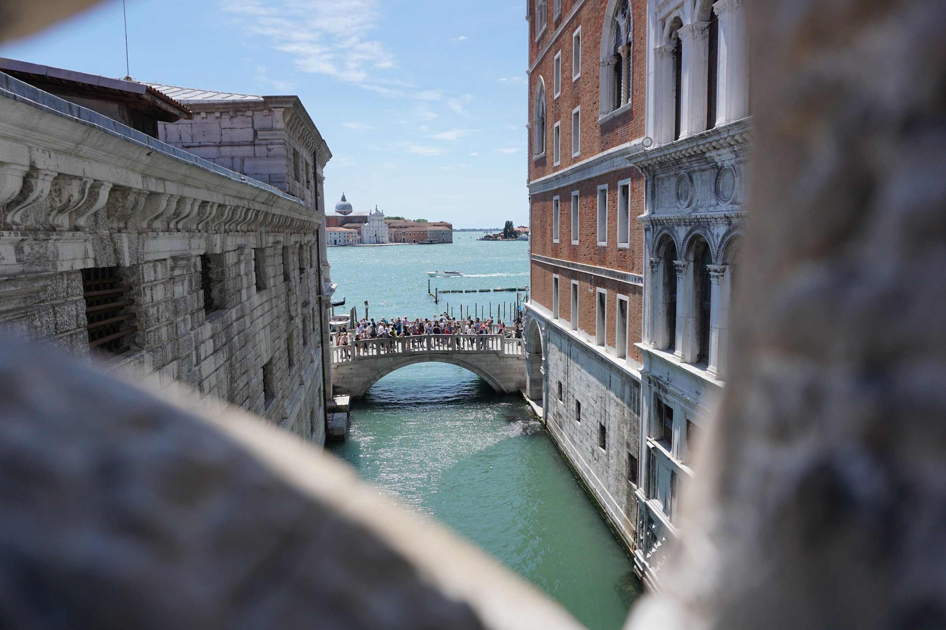

Slide 45
